Slide 1

Notes:
Welcome to the Theatre Green Book

Slide 2
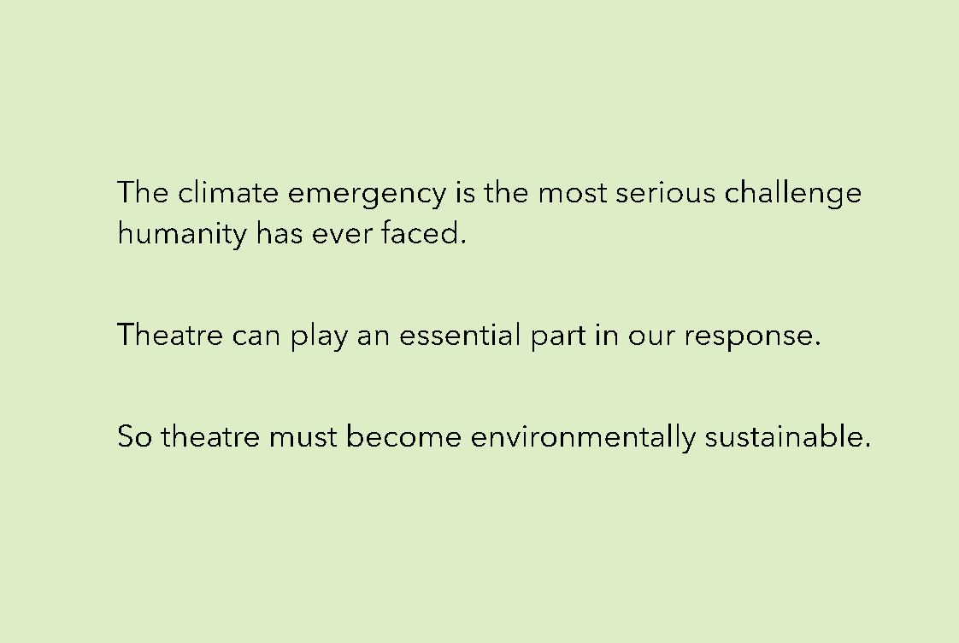
Notes:
Context: why do we need theatre to be sustainable?

Slide 3

Notes:
This is a 3 minute introductory video (click CC for captions)

Slide 4
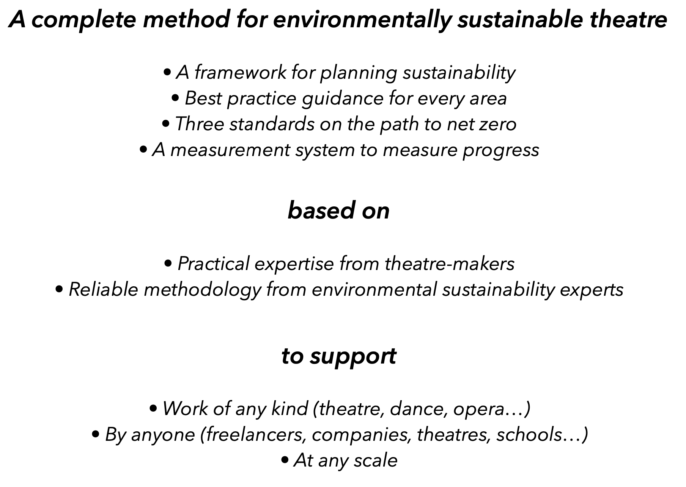
Notes:
What is Theatre Green Book: it is an industry wide endeavour, created by the theatre industry for the theatre industry. It creates a framework and common language for best practice. It covers all sizes and types of theatre across the UK (including freelancers), and also includes dance, opera and touring.

Slide 5
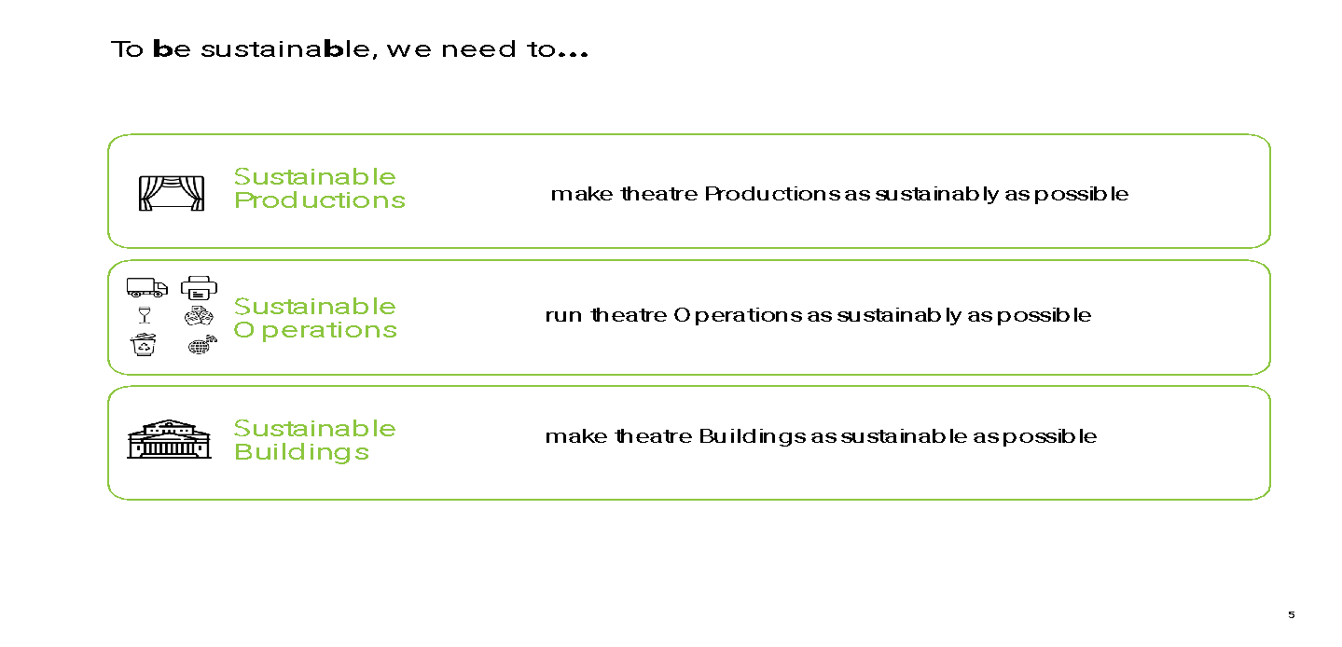
Notes:
Theatre Green Book covers the three areas of Productions, Operations and Buildings

Slide 6



Notes:
Who is behind Theatre Green Book?: the Theatre Green Book has been contributed to by people working across the industry. It now has three main advisory committees: Productions, Operations and Buildings. There is also a Steering Committee made up of the members in this slide. Buro Happold are an engineering firm, and sustainability experts to ensure Theatre Green Book is underpinned by the latest sustainability guidance.

Slide 7
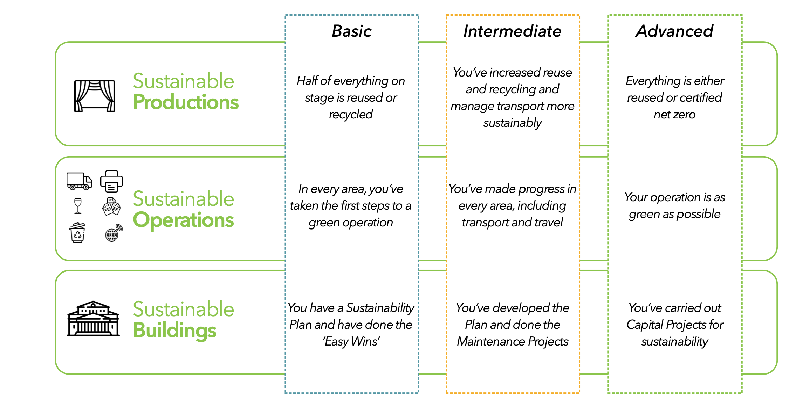
Notes:
There are three areas to the Theatre Green Book: Productions, Operations and Buildings. You then work your way through from Basic, to Intermediate to Advanced.

Slide 8
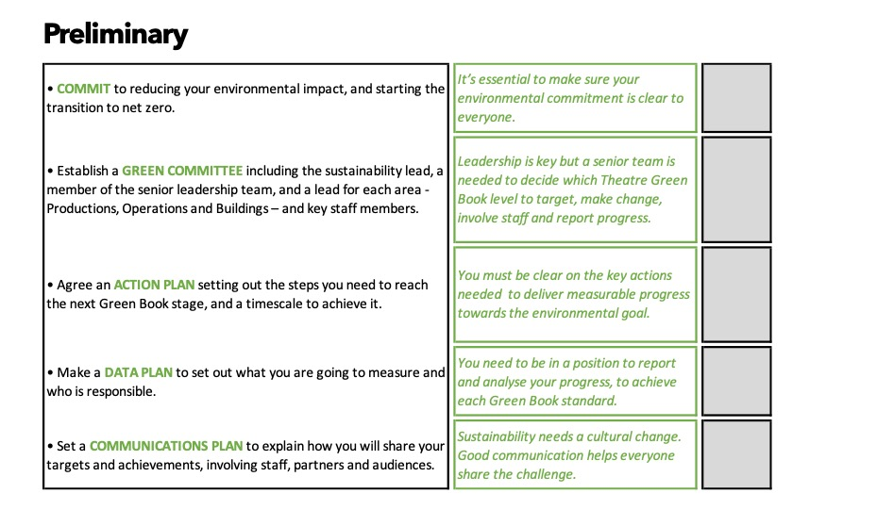
Notes:
Before you get started working towards Basic, there’s a Preliminary stage. This is for organisations who are very early on in their sustainability journeys. Preliminary should be achievable for anyone as it about setting up intentions, plans and targets.

Slide 9
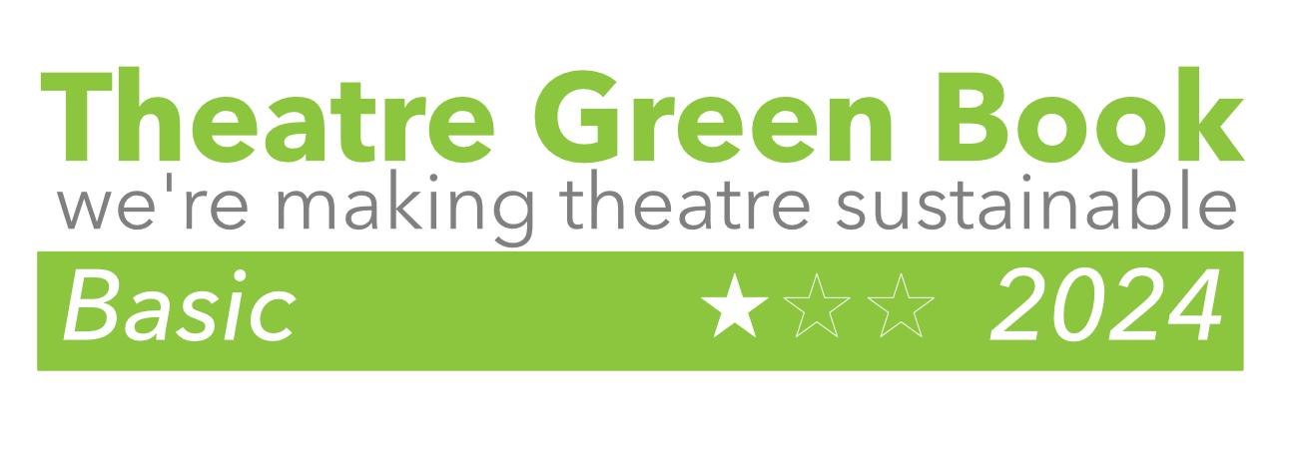
Notes:
Theatre Green Book is a self-certified process. So once an organisation has signed up the website, it can go through each level, uploading the relevant checklists and downloading logos, like the above, which can then be shared with staff, partners and audiences.

Slide 10

Notes:
What resources are available? On the Theatre Green Book website, resources are broken down into the three areas: Productions, Operations and Buildings.

Slide 11
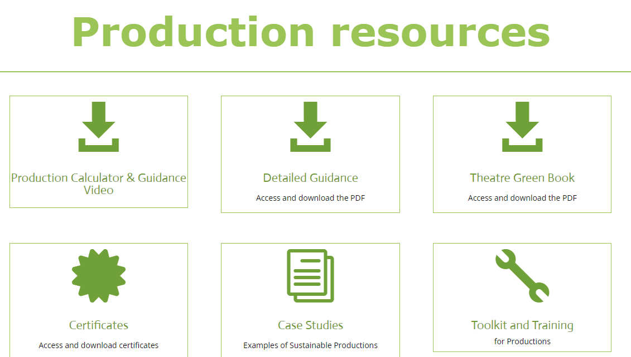
Notes:
Under each section (this example is Productions) you can see the Productions Calculator at the top, but also Detailed Guidance, the full Theatre Green Book itself, Case Studies and Toolkits.

Slide 12
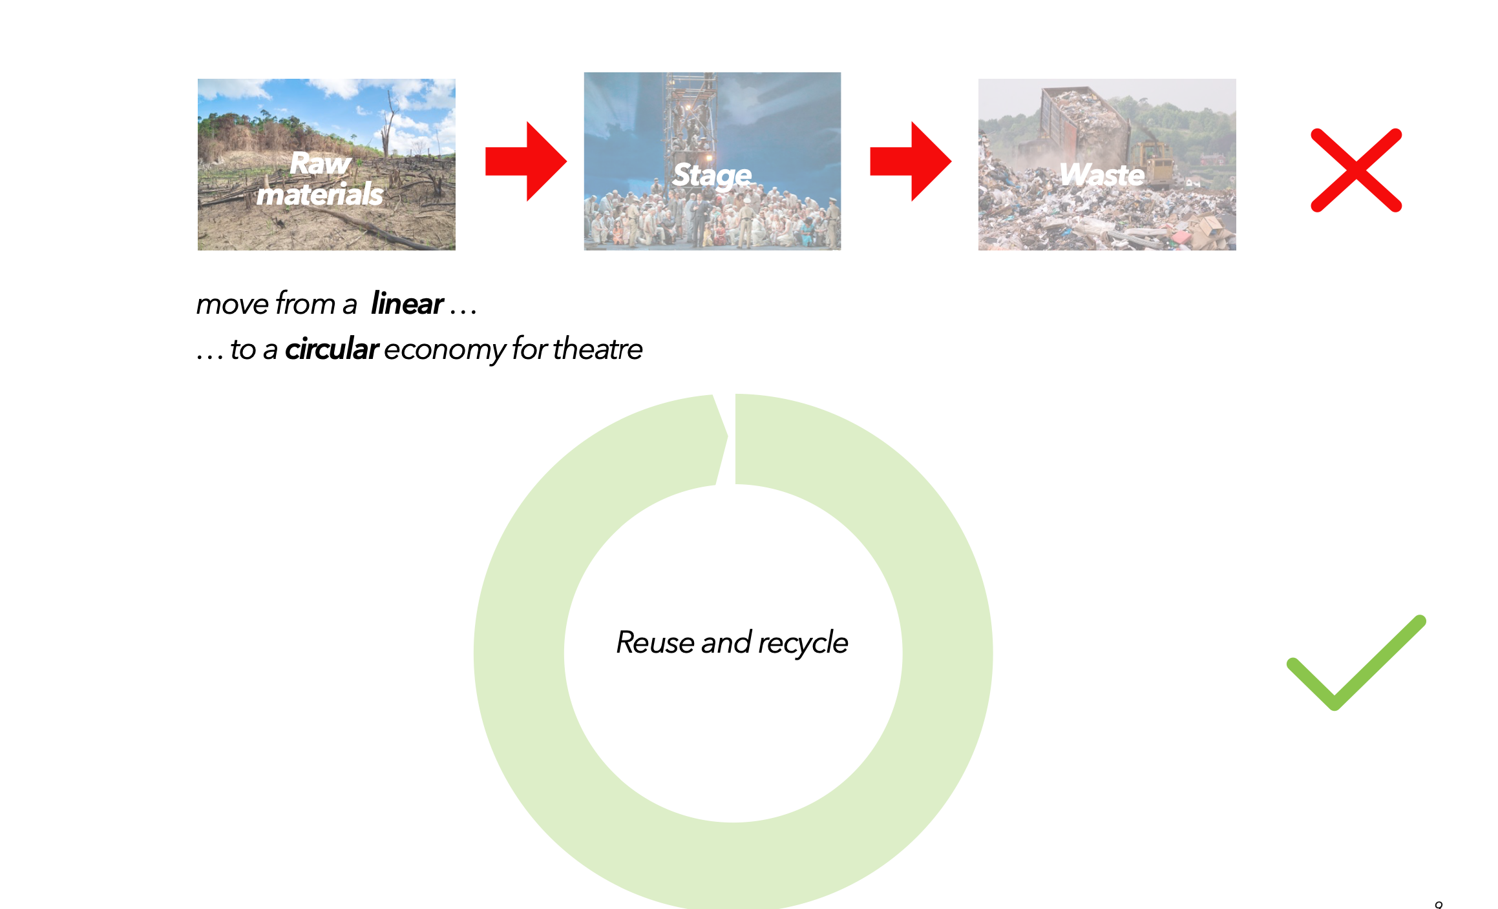
PRODUCTIONS OVERVIEW
Notes:
So, what is in the Theatre Green Book? This is the overview of the essential thoughts behind Productions.

Slide 13
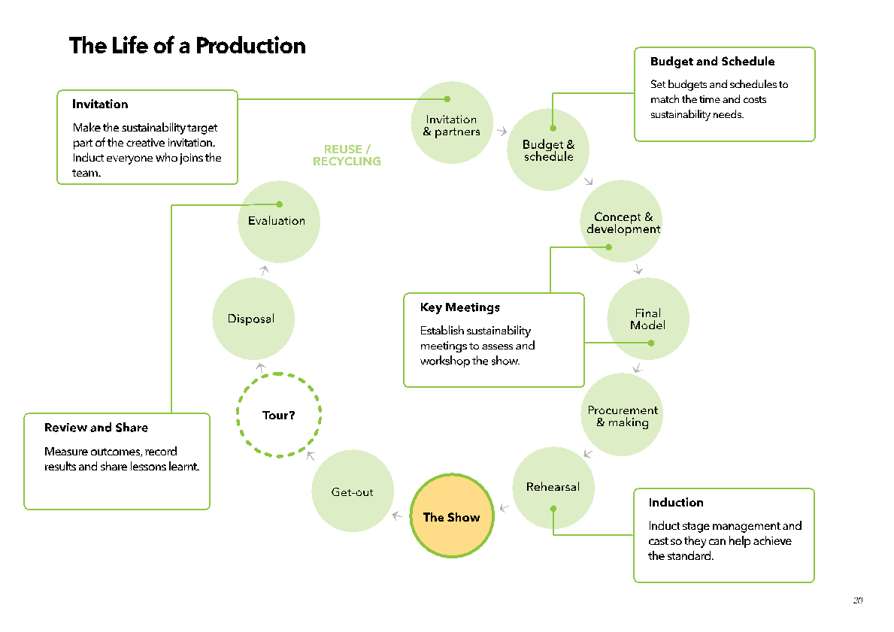
Notes:
All aspects, team members and stages of the production process should be considered.

Slide 14
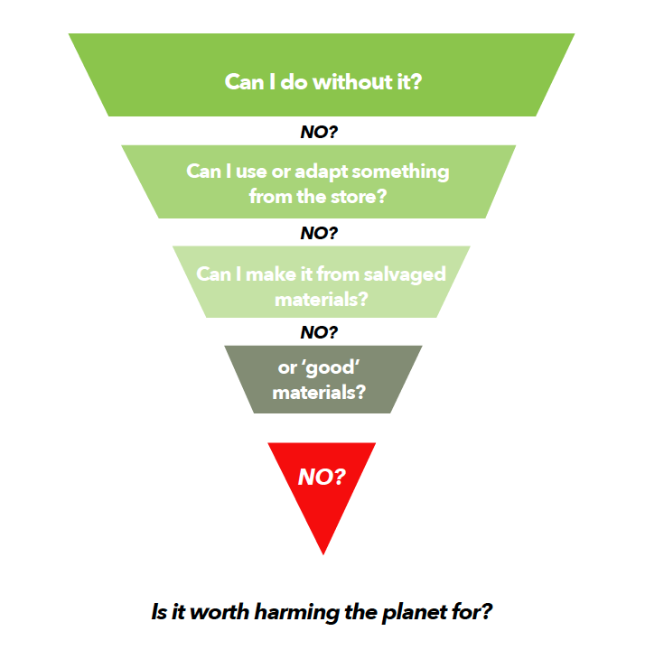
Notes:
This is the pyramid of intentions, part of the Productions Theatre Green Book.

Slide 15
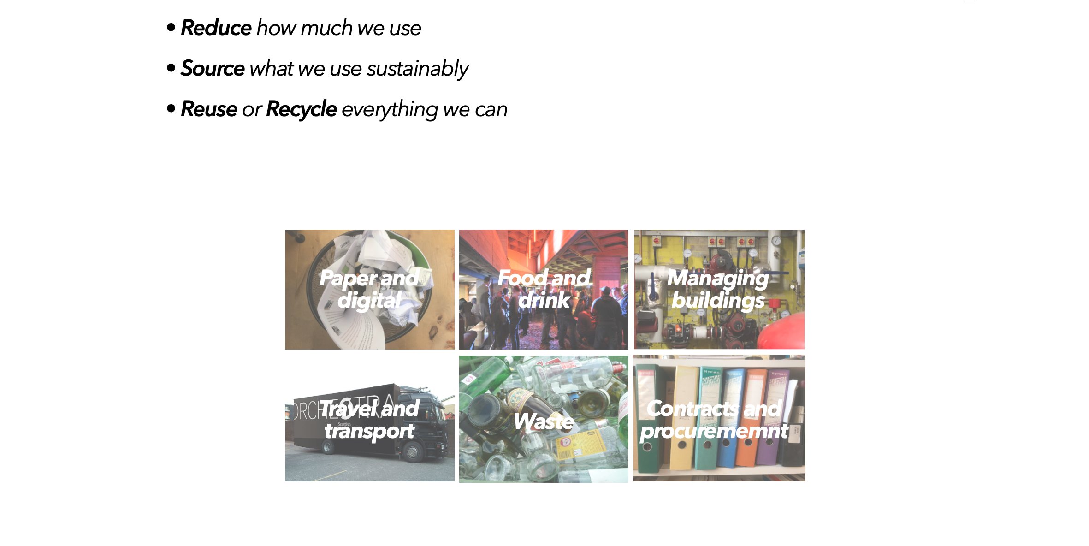
OPERATIONS OVERVIEW
Notes:
This is the overview of the essential thoughts behind Operations, split out into Paper and Digital, Food and Drink, Managing Buildings, Travel and Transport, Waste and Contracts and Procurement.

Slide 16
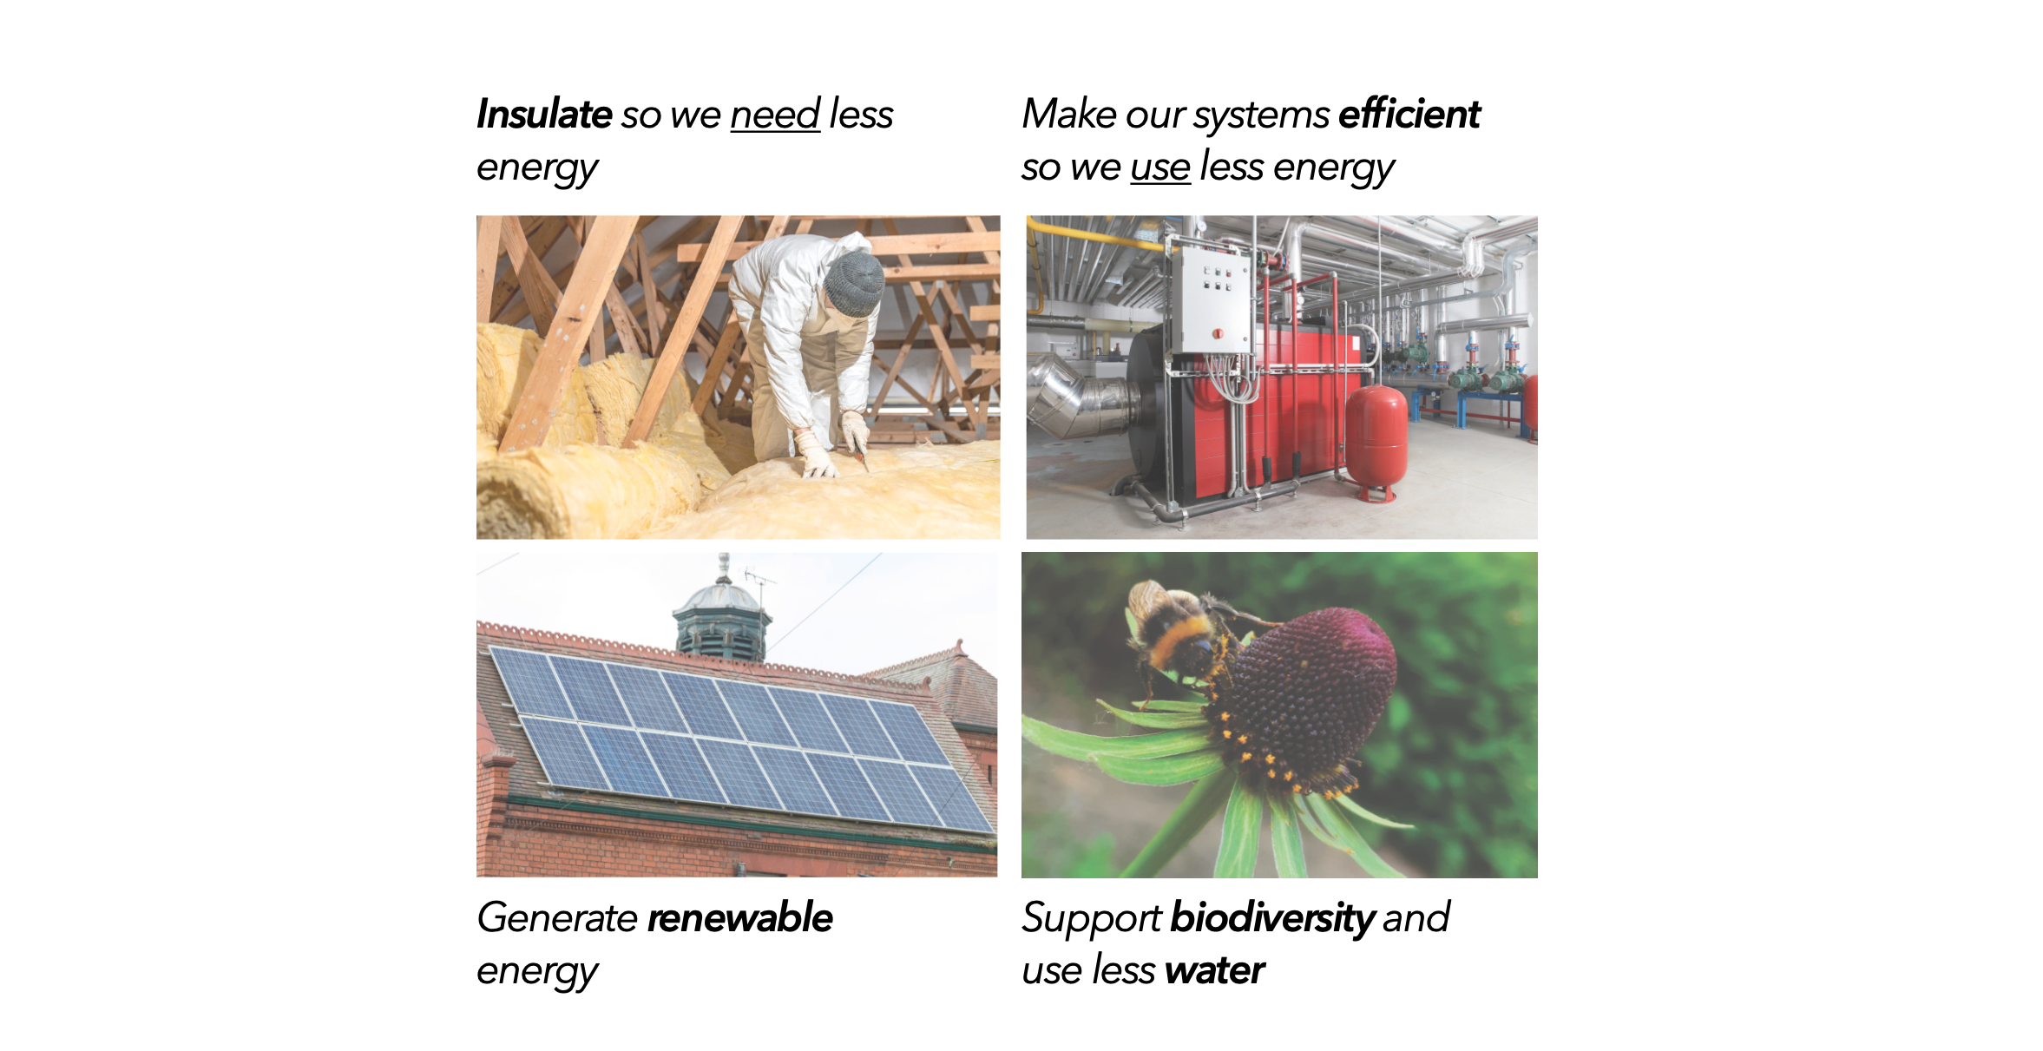
BUILDINGS OVERVIEW
Notes:
This is the overview of the essential thoughts behind Buildings, breaking it down into Insulation, Efficiency, Renewable Generation, Biodiversity and Water.

Slide 17
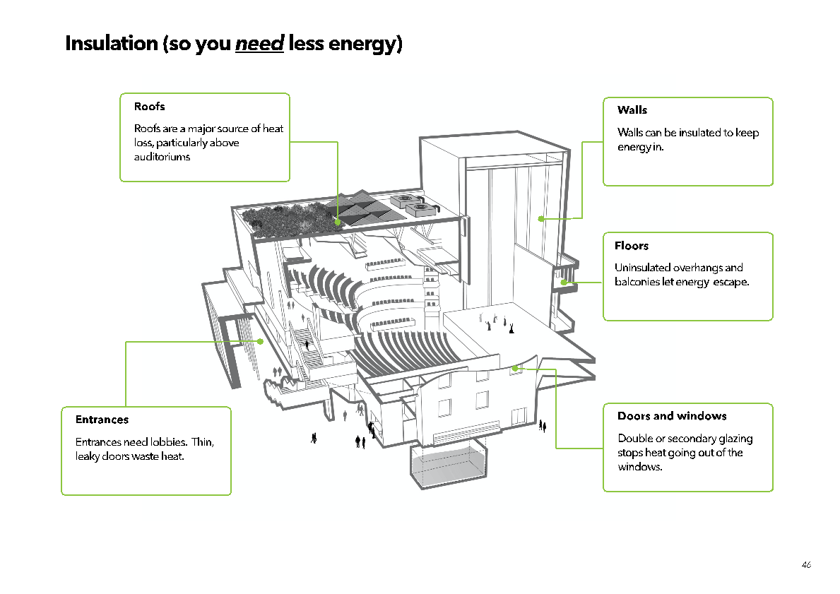
Notes:
All parts of a Building are covered in the Theatre Green Book: from Easy Wins to Capital Projects.

Slide 18
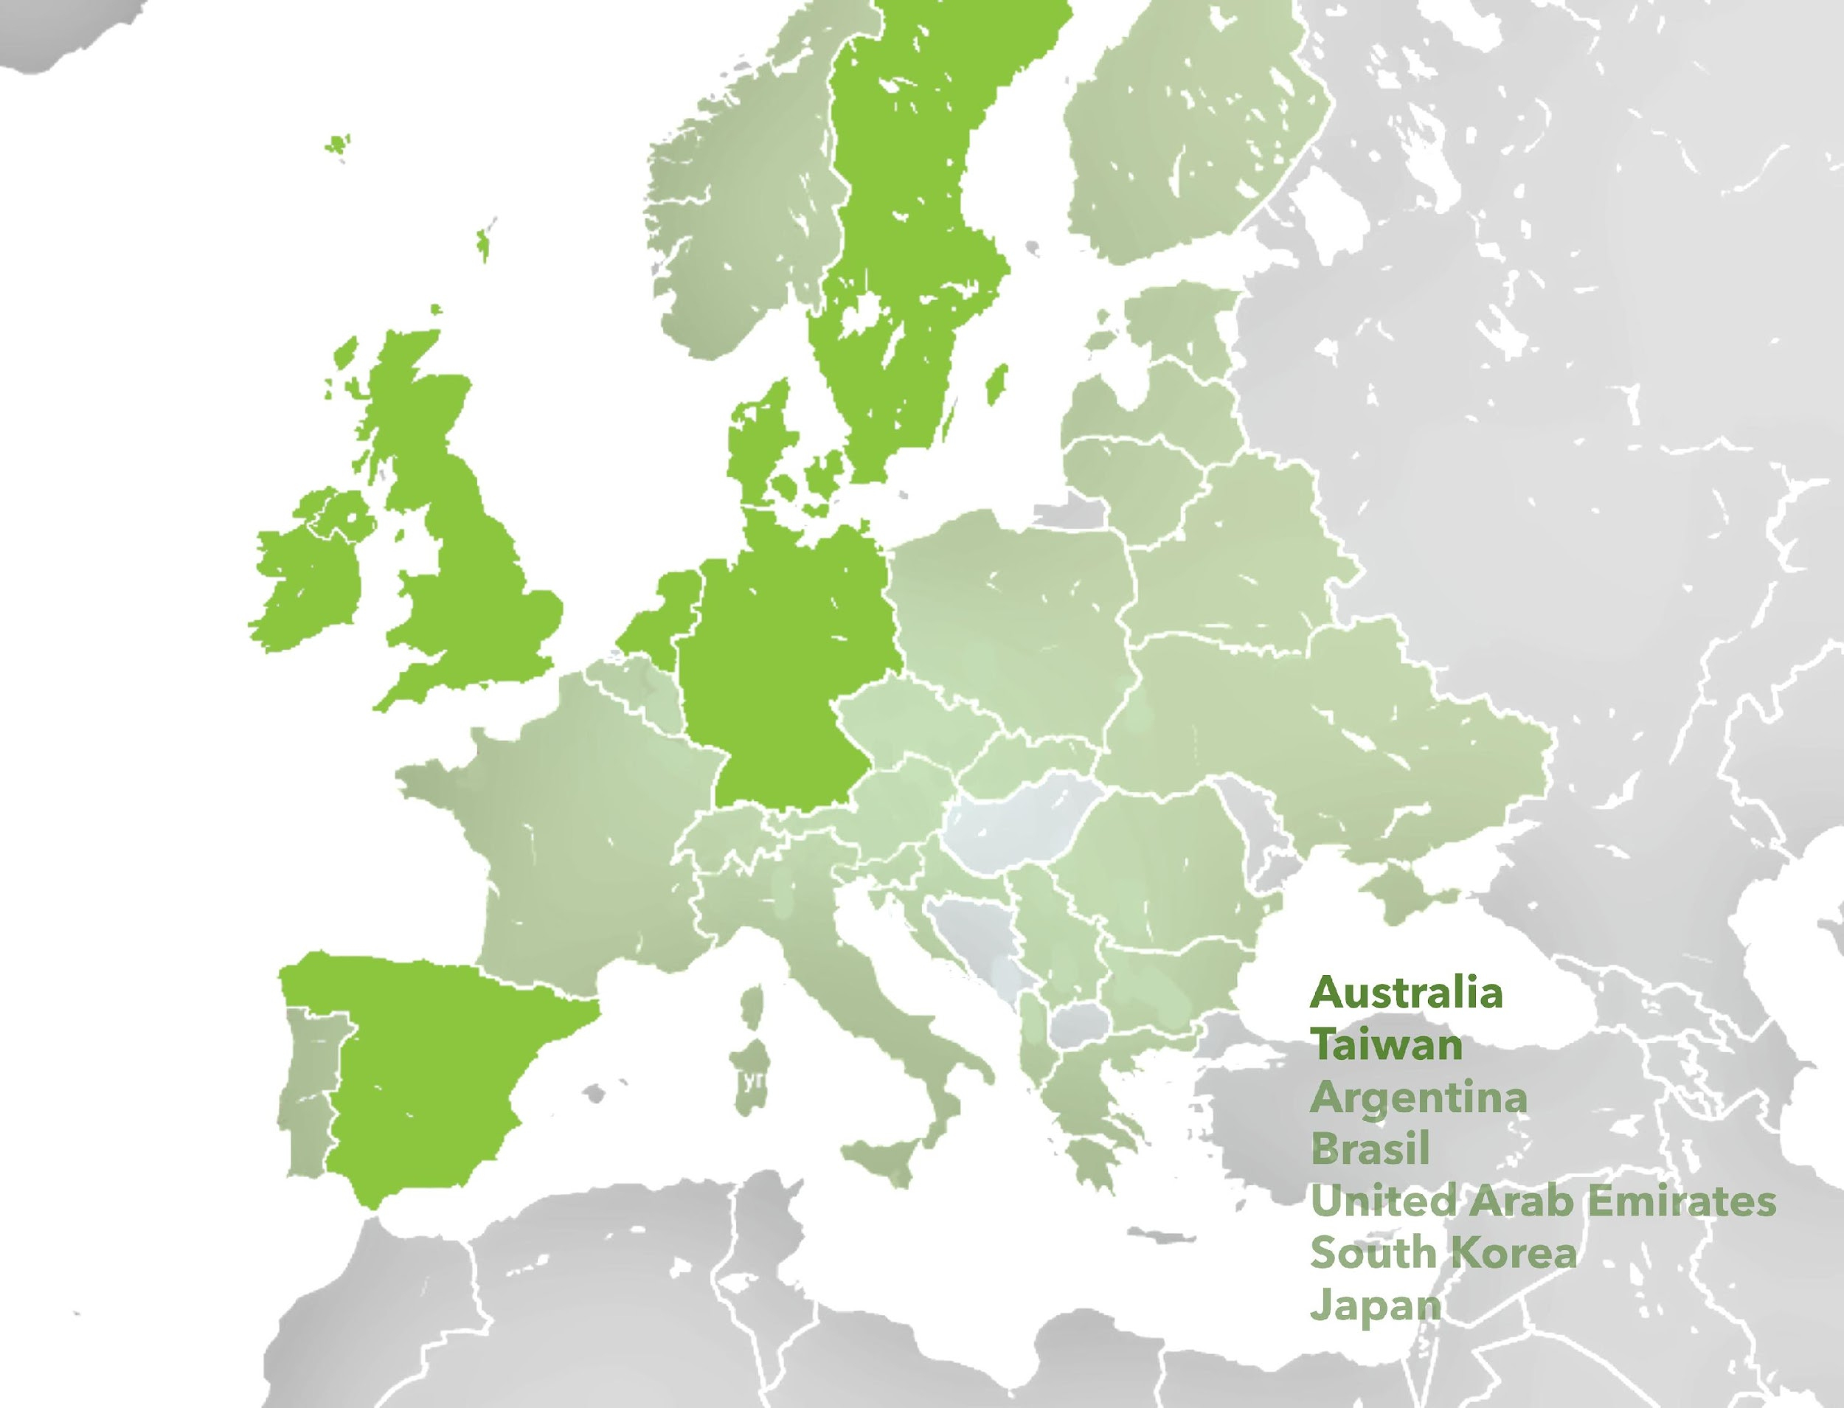
Notes:
The Theatre Green Book is already being used across the World. Above are some of the countries with translations or adaptations to suit their national way of theatre making, whilst still underpinned by Theatre Green Book standards.

Slide 19
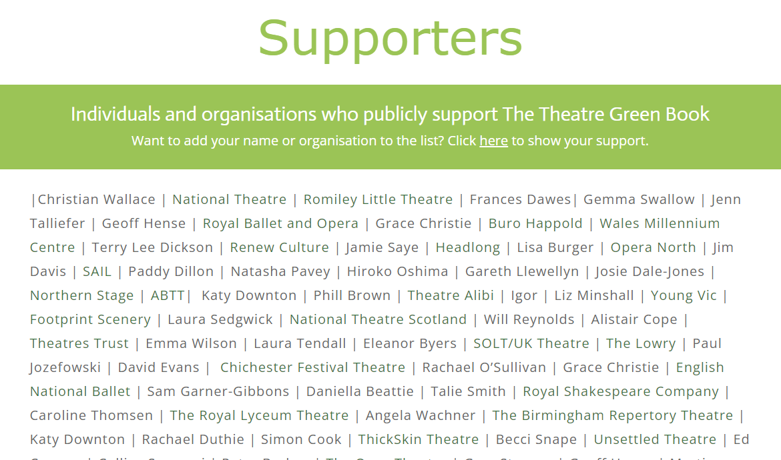
Notes:
Greener theatre is already being made across the UK and beyond, with so many brilliant innovations and additions being made all the time. You can visit the Supporters page to see Individuals and Organisations already using the Theatre Green Book.

Slide 20
How are you using/how could you be using the Theatre Green Book in your work?

Slide 21
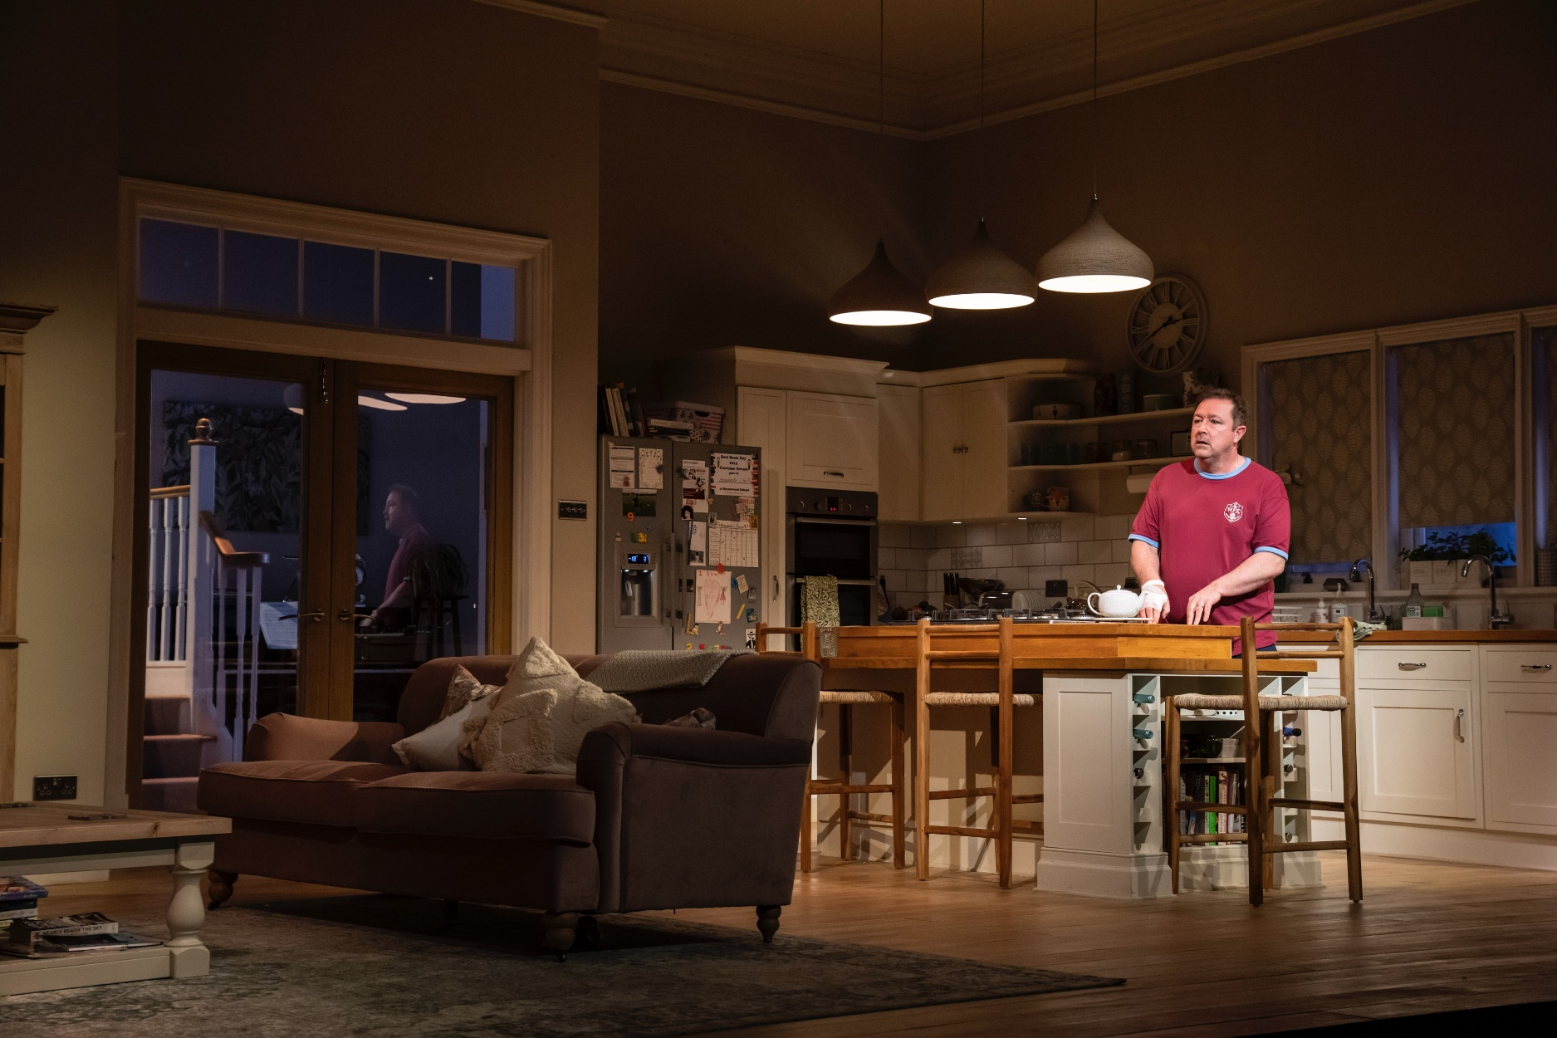
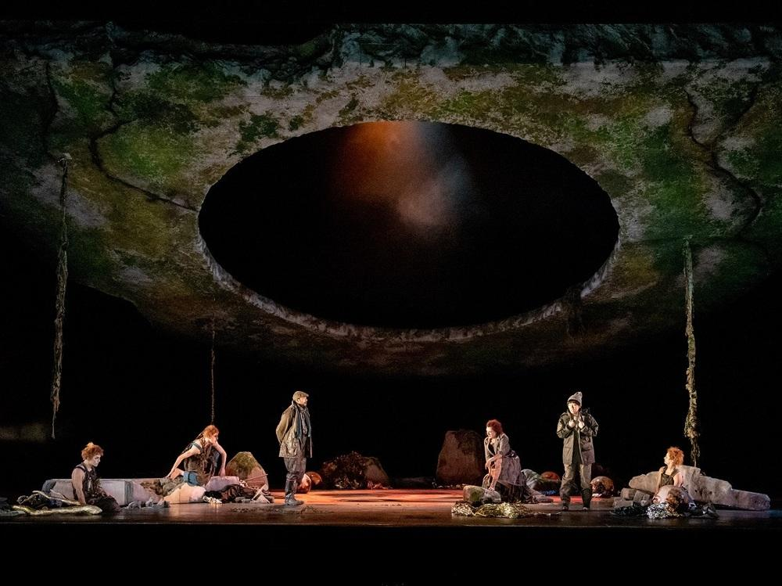
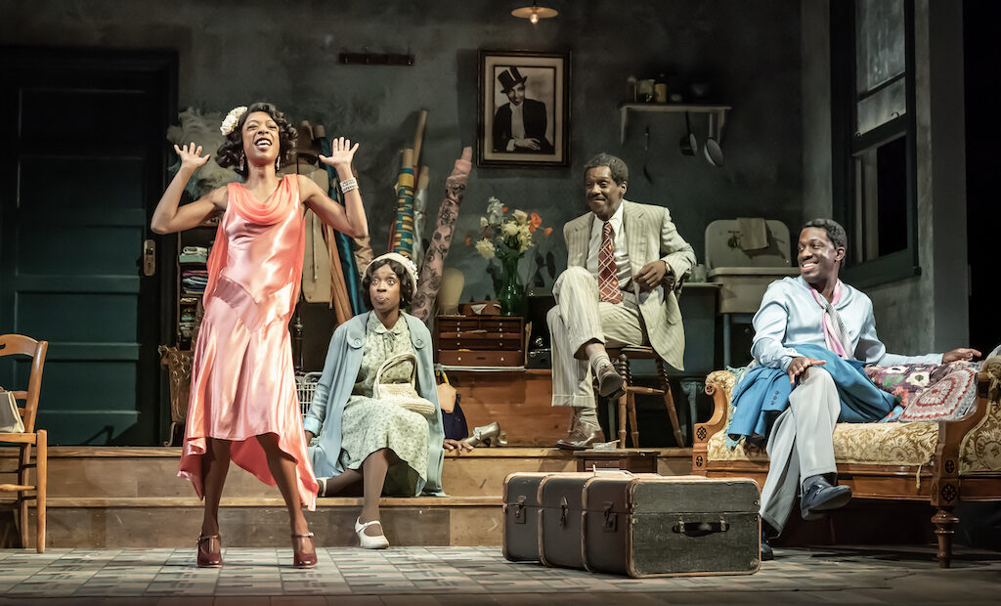
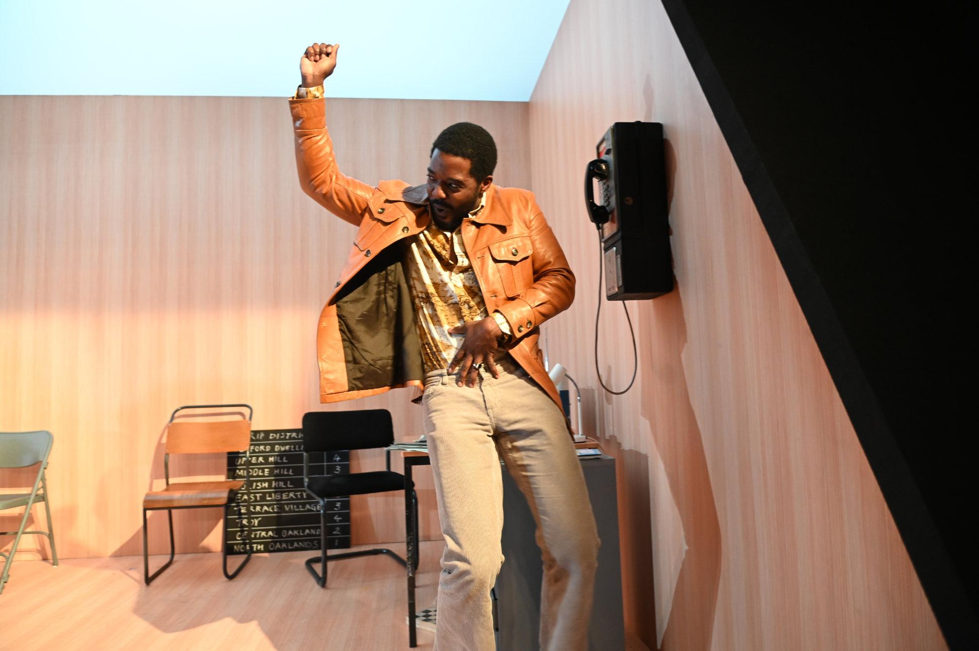
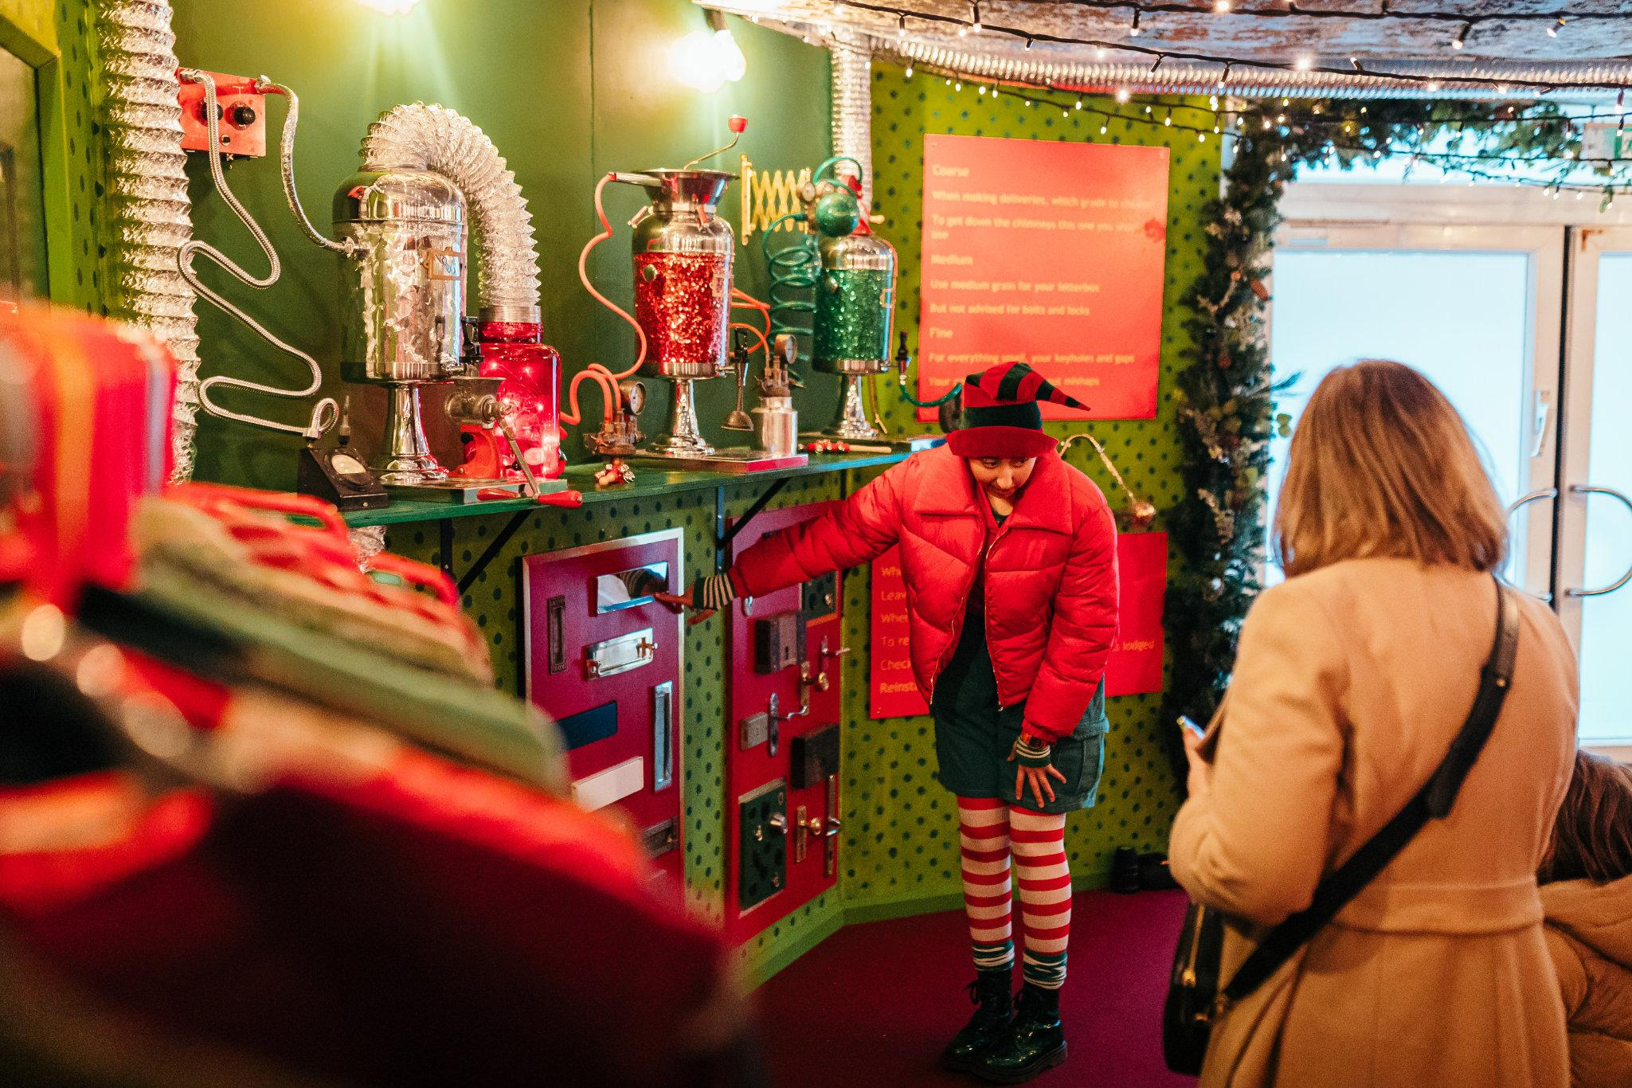
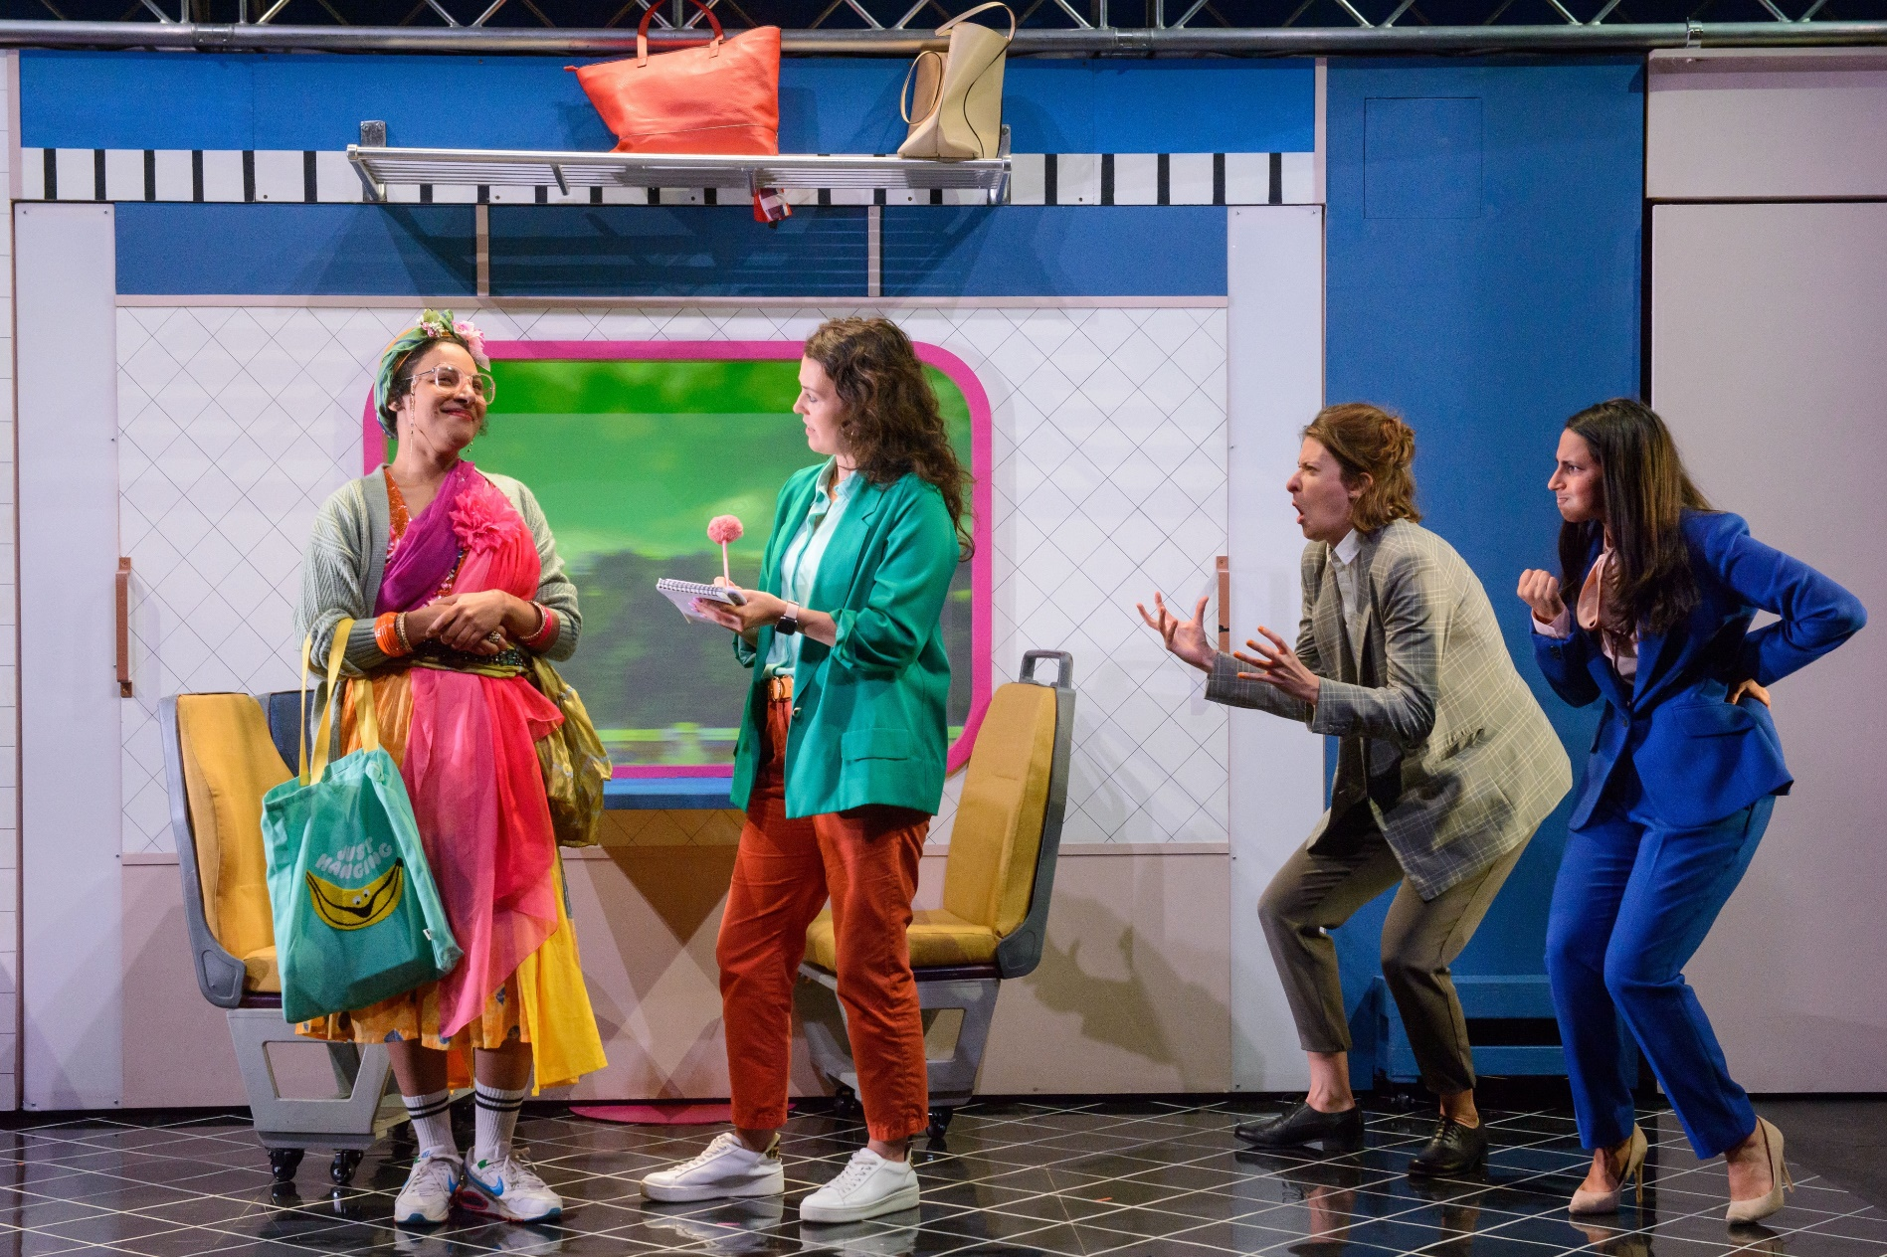
Notes:
Images of productions made using Theatre Green Book

Slide 22
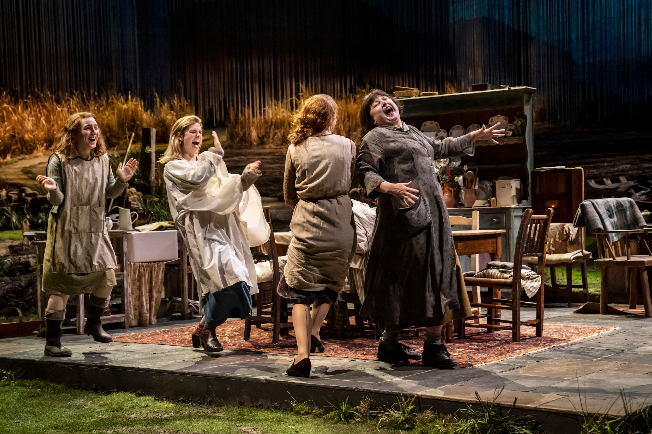
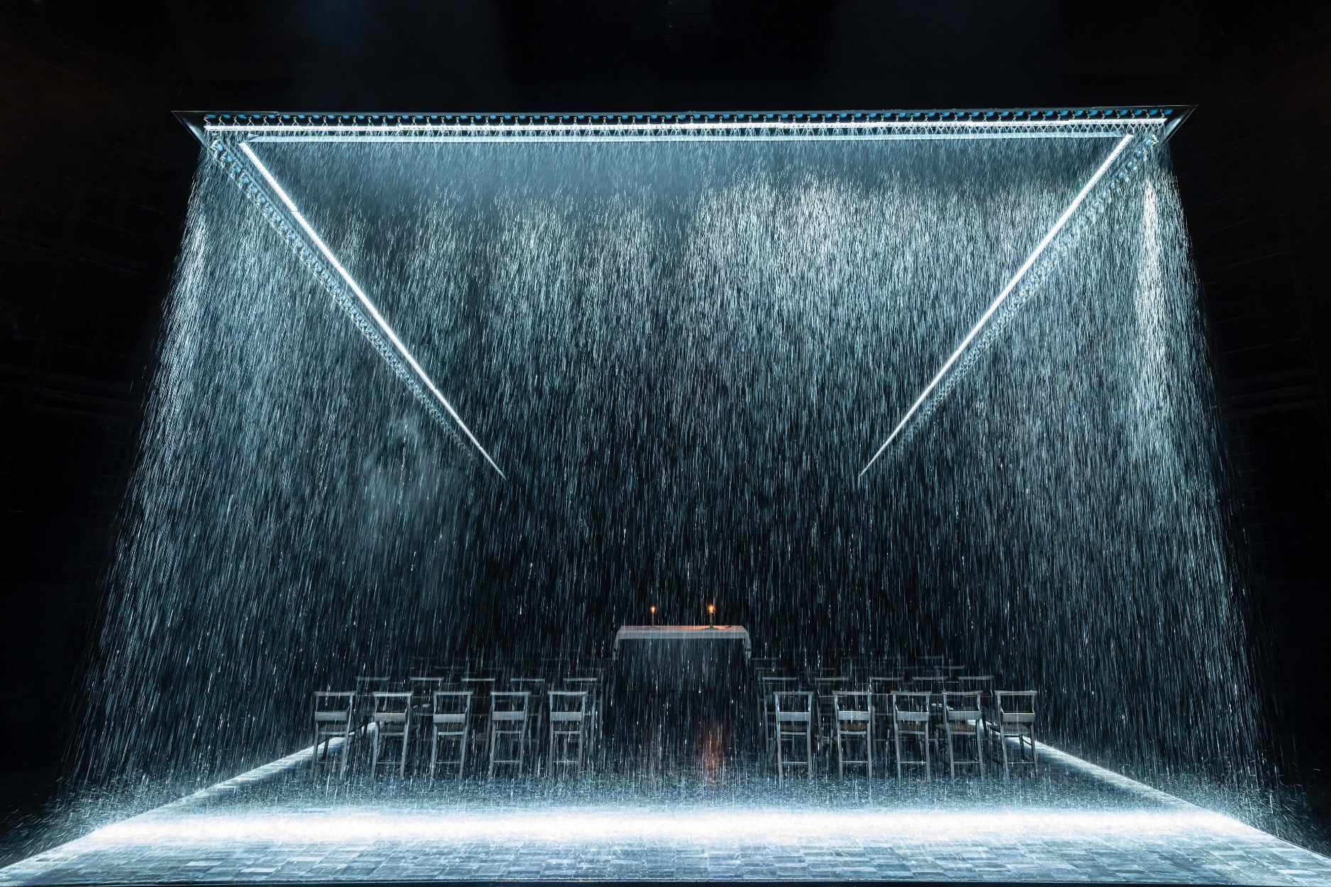
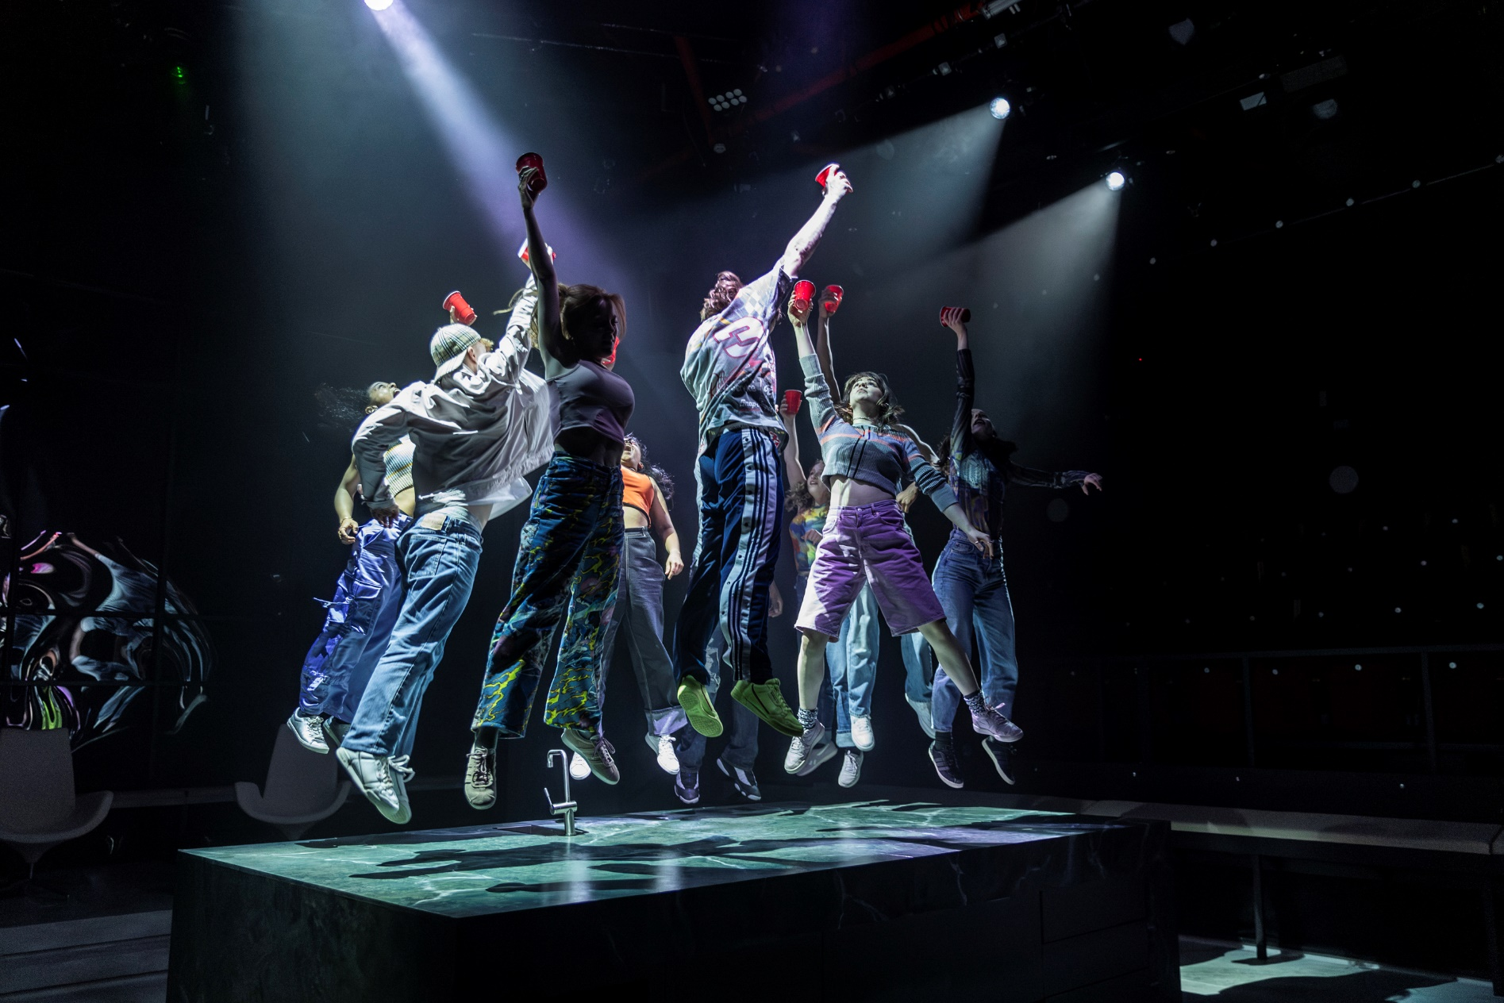
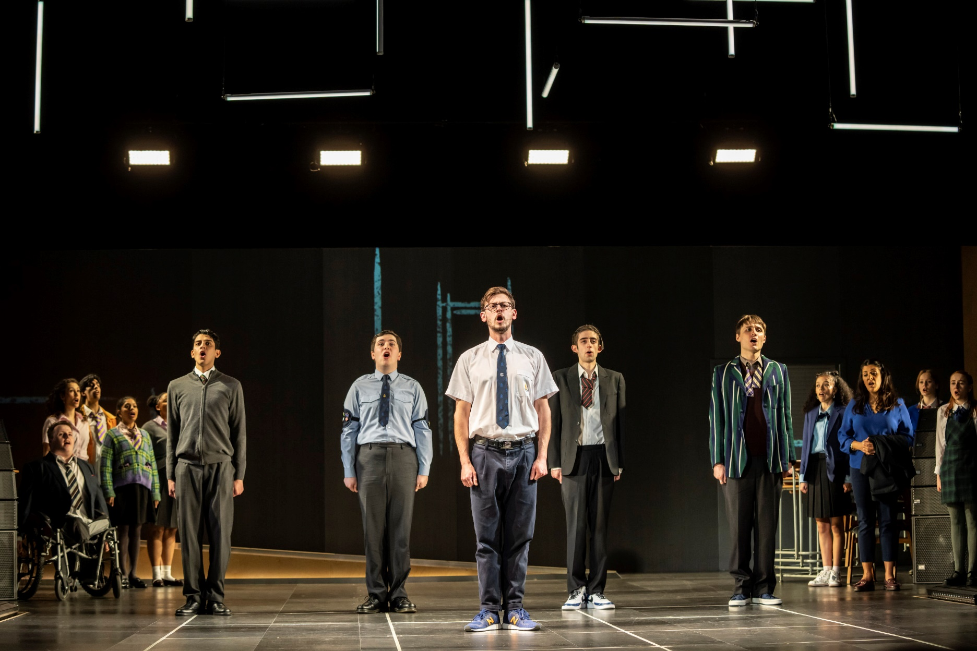
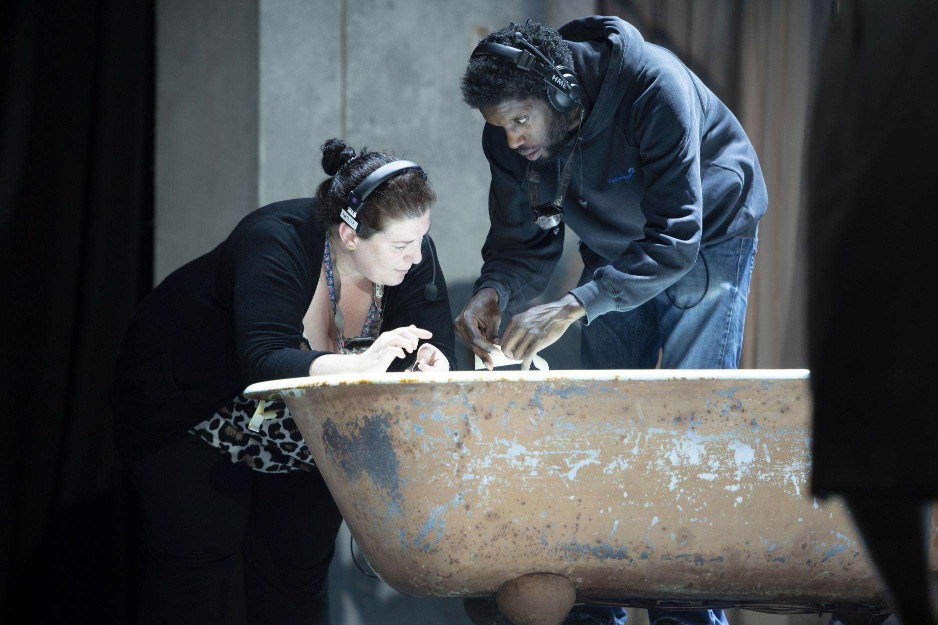
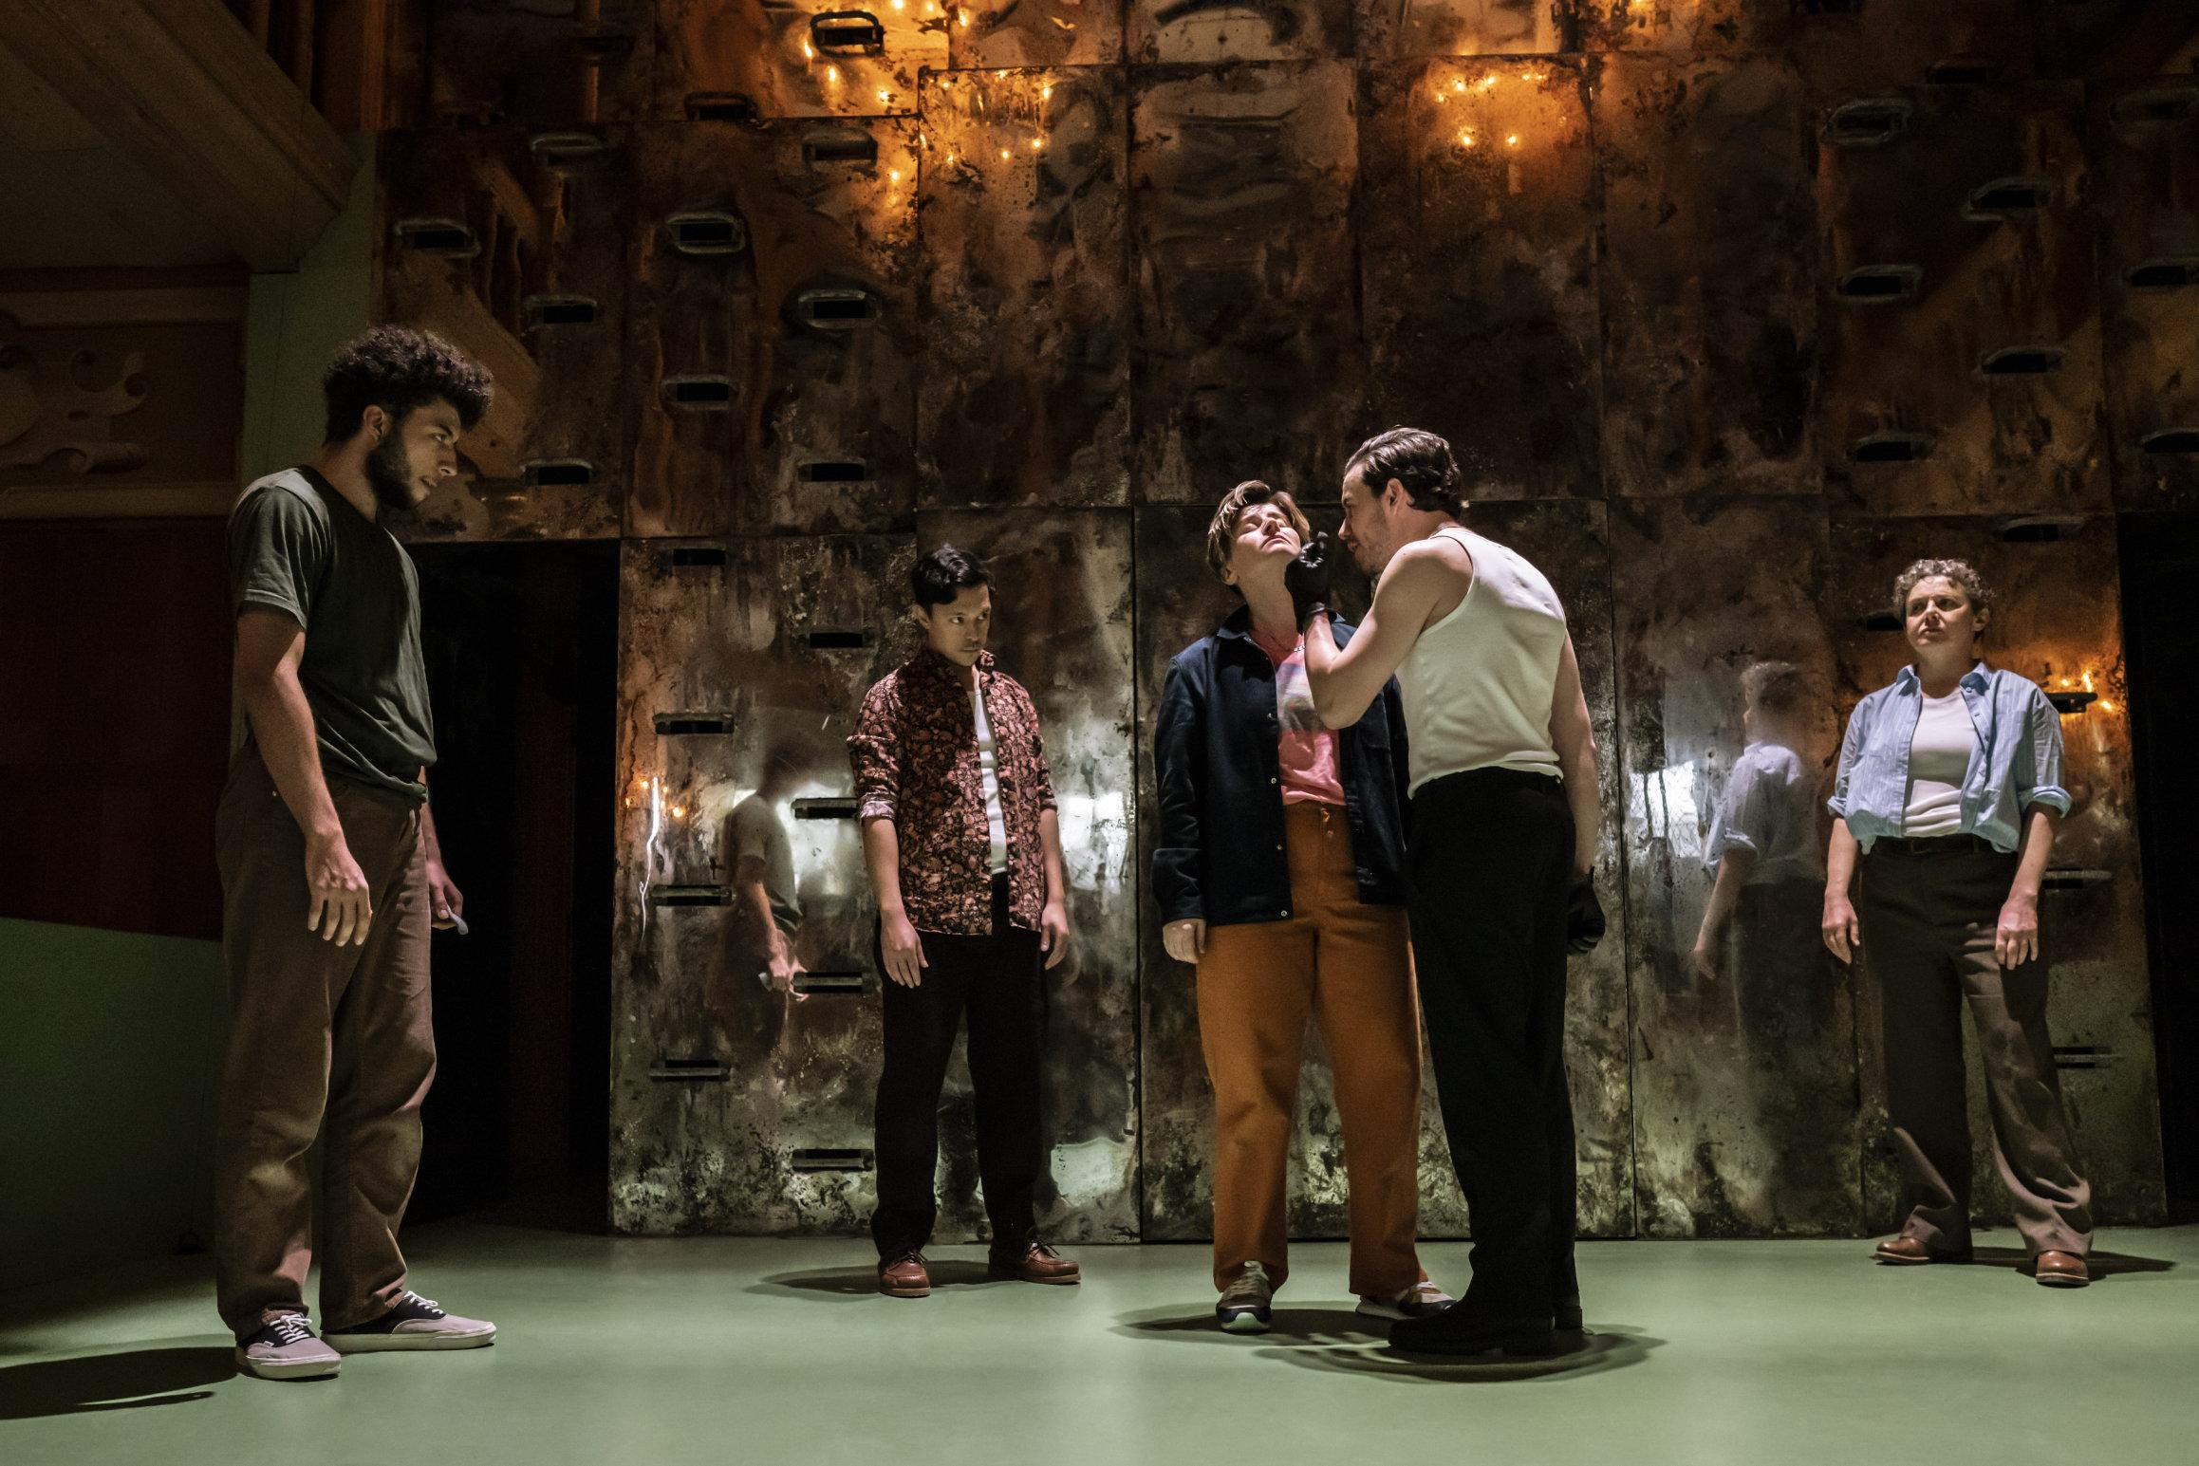
Notes:
Images of productions made using Theatre Green Book

