Slide 1
Refurbishment of Theatre Main Entrance
November 2024

Slide 2
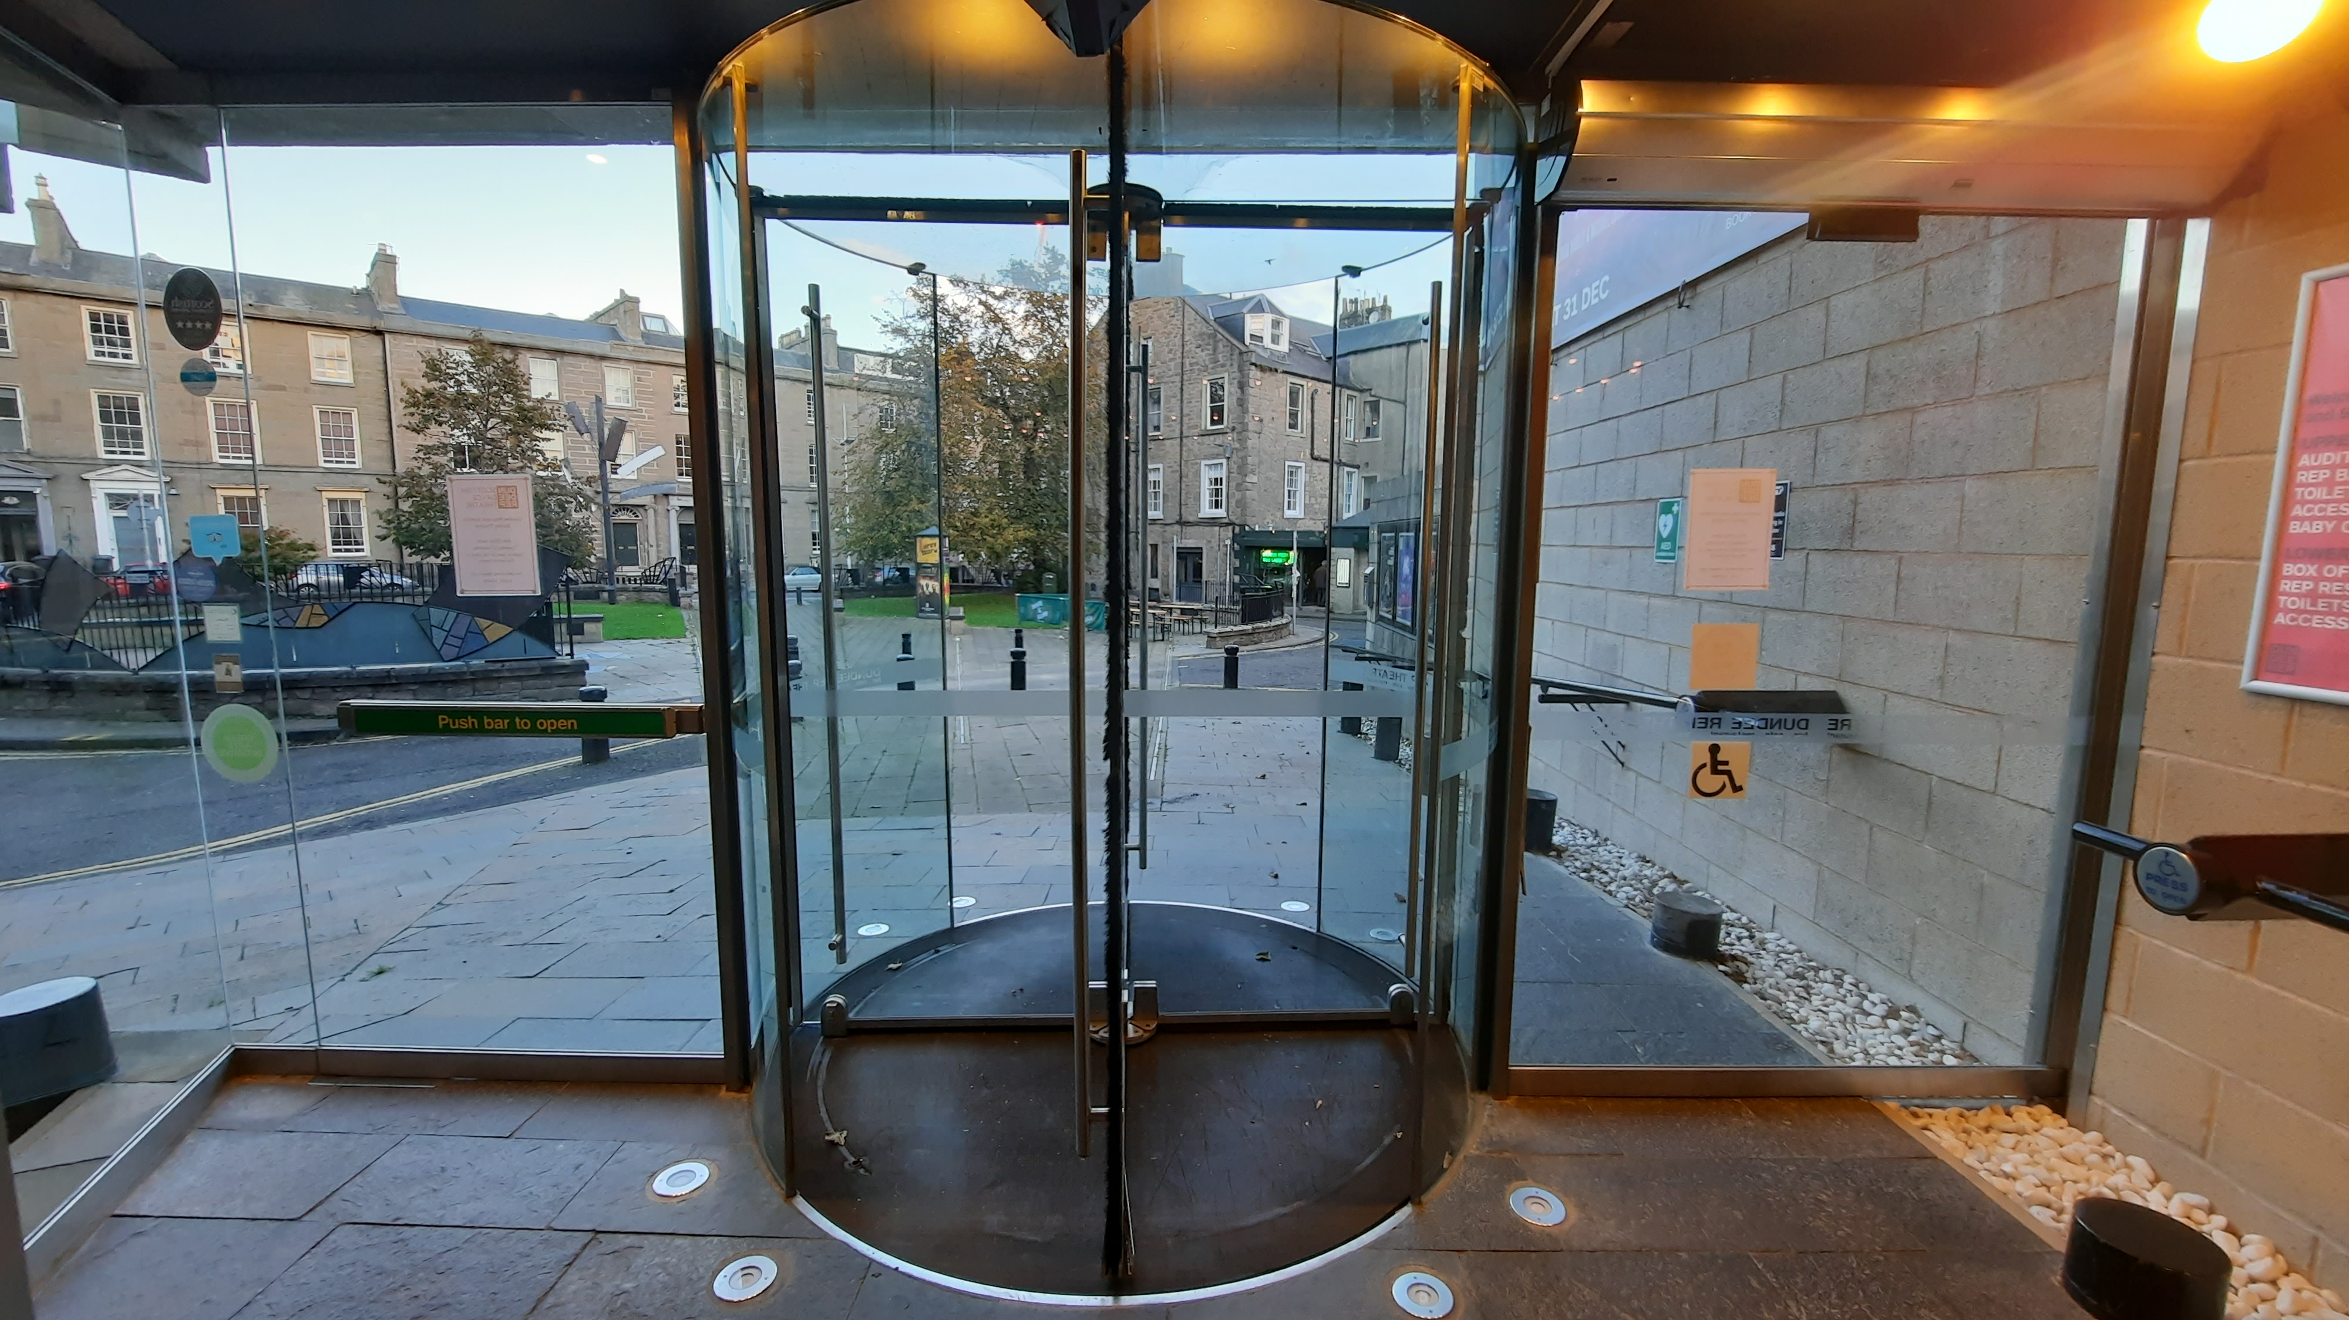
How it did look

Slide 3
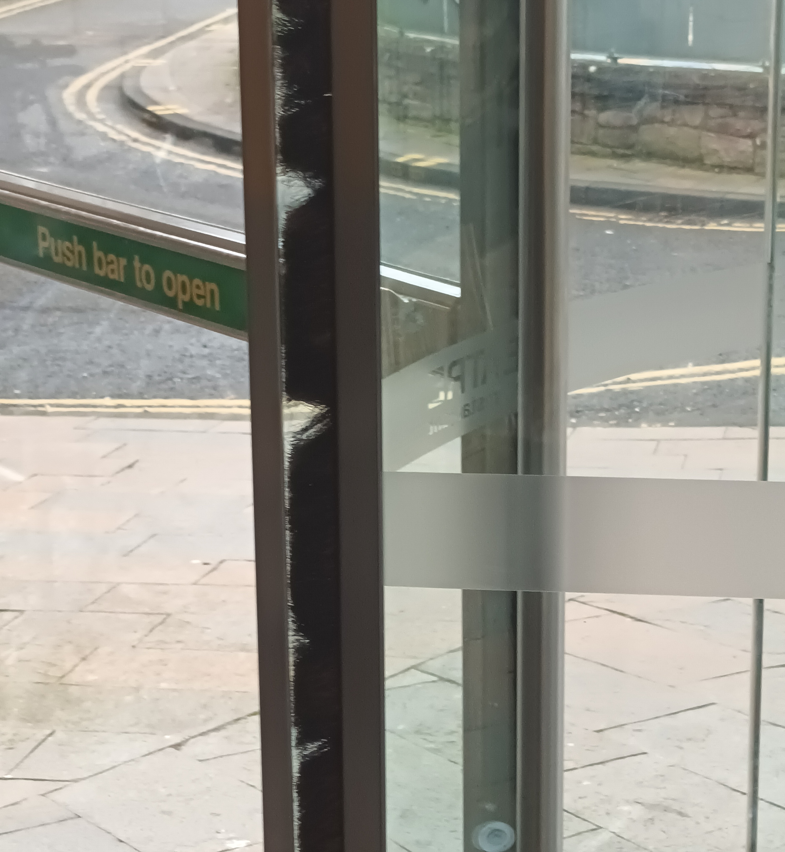
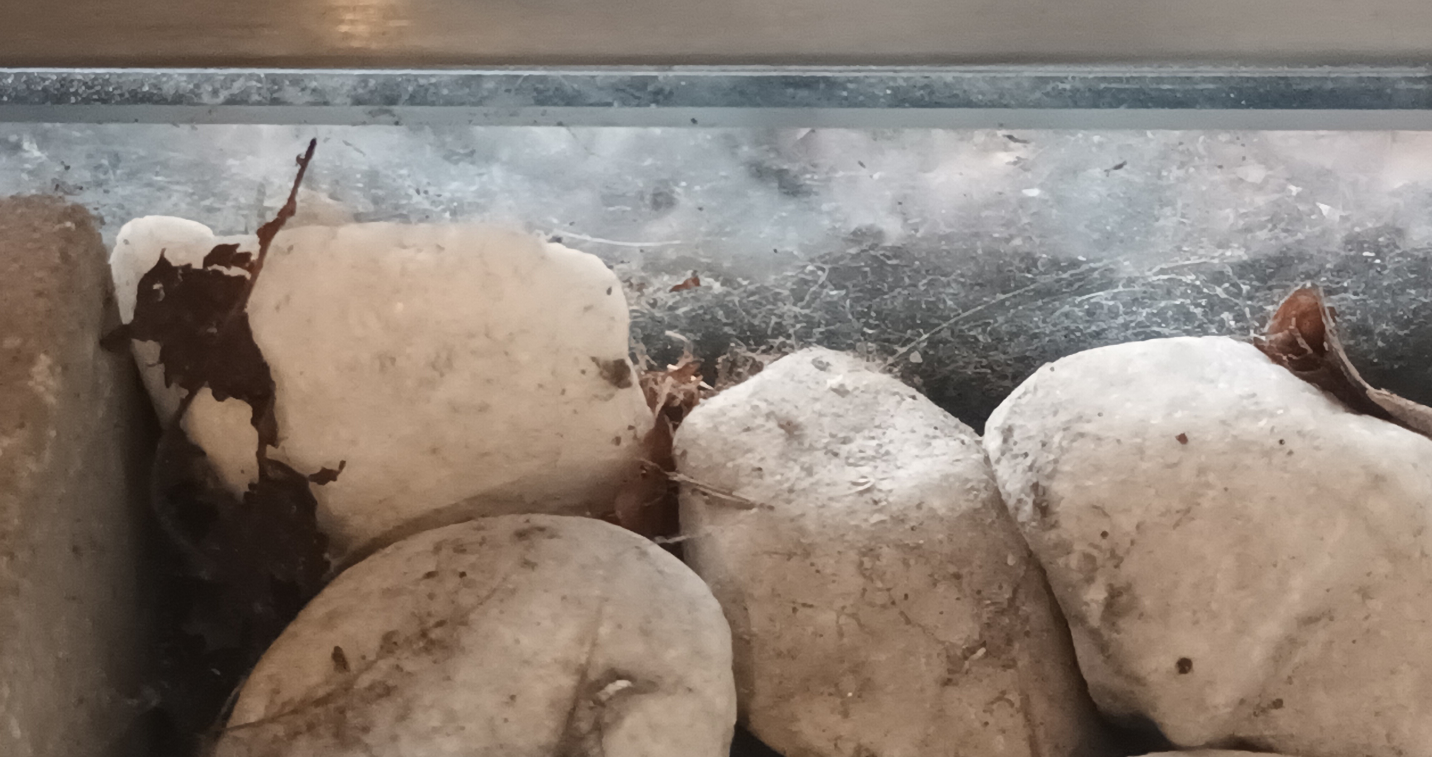
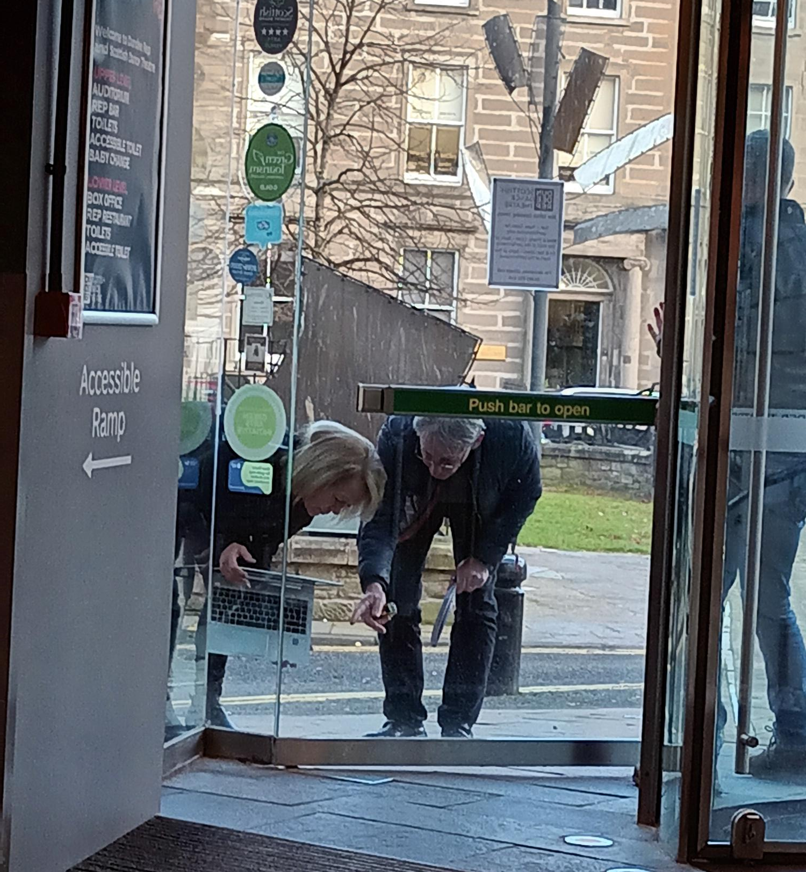
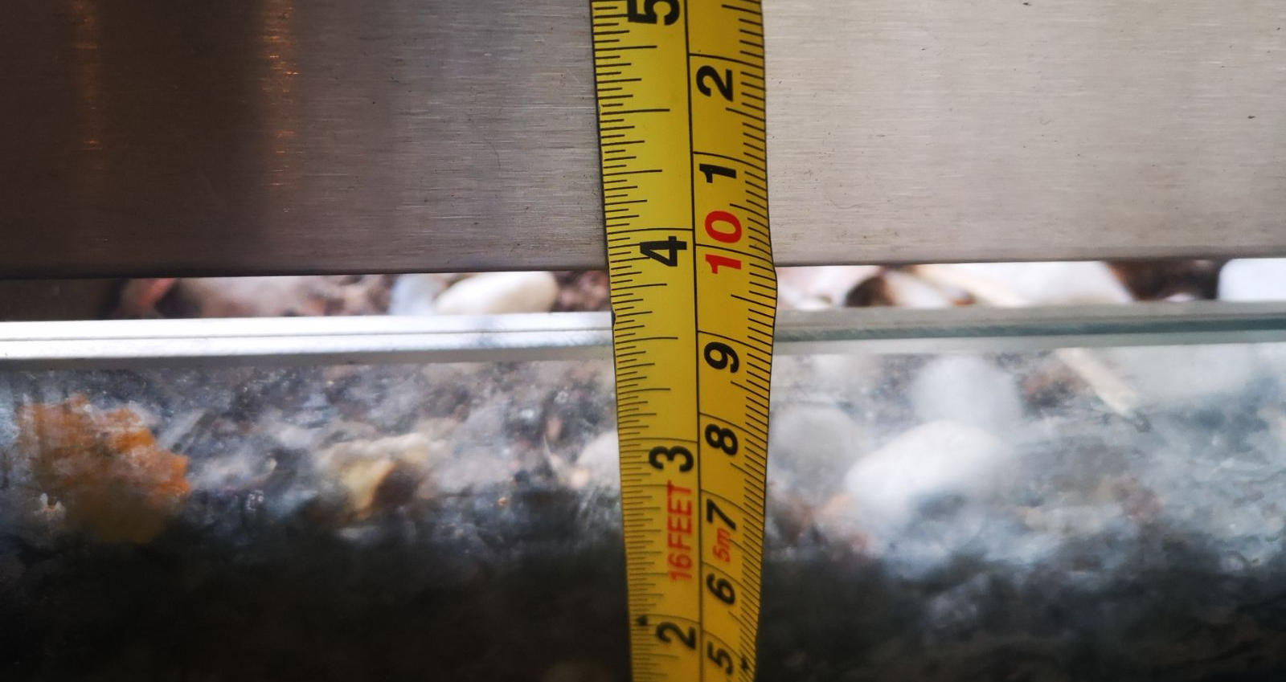
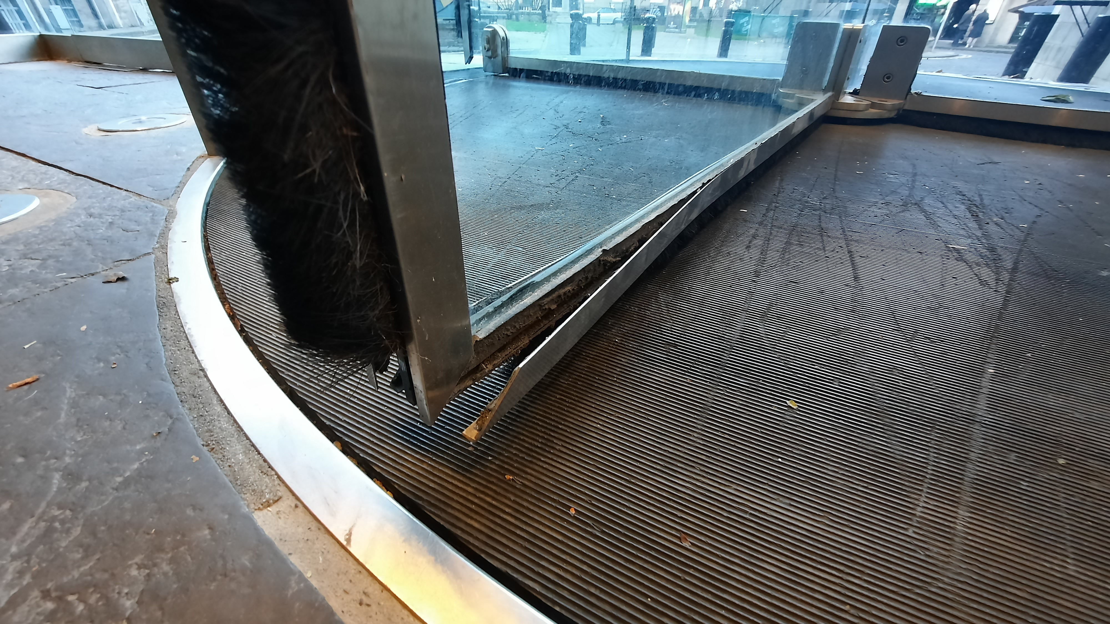
The Issues

Slide 4
The Issues
Huge gaps under the accessible and fire exit doors
The Revolve brushes had gaps and some missing
The metal work on the revolve was dangerous
The foyer area was very cold as low as 13oC in winter with the heating on.
Safety concerns with the revolve
Accessible door constantly breaking down

Slide 5
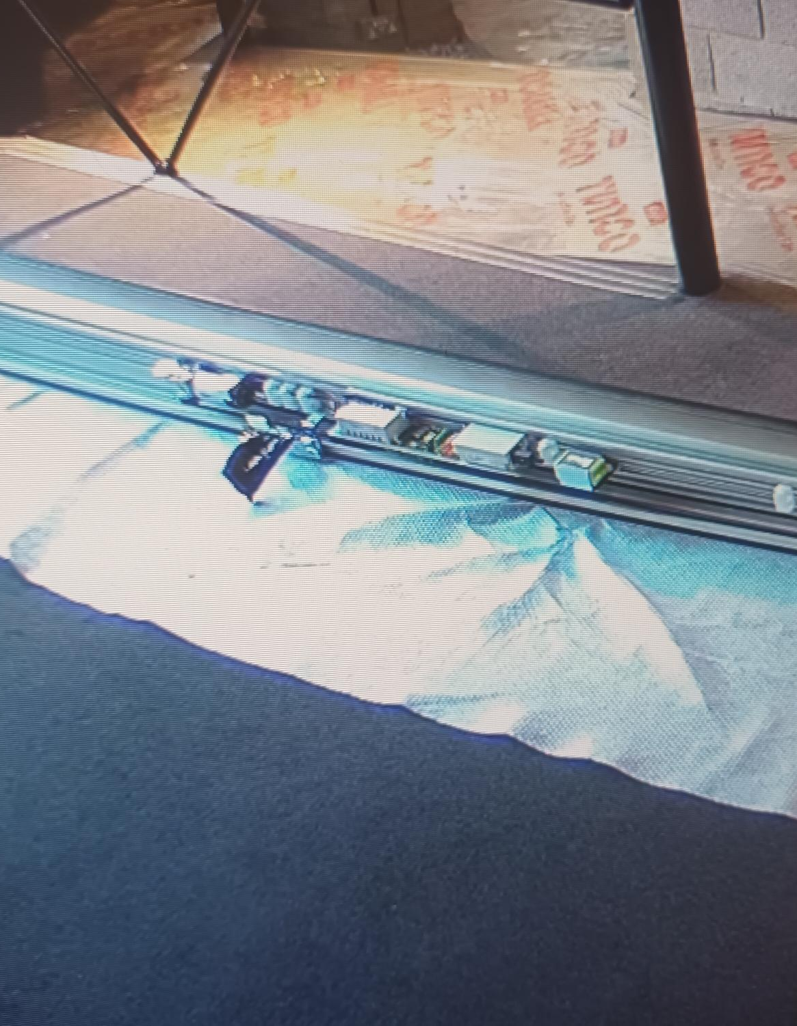
The Plan
Design a new automatic well fitted door and fire exit
To include an Air slide (pictured left)
Gain Planning permission from Planning and HES (A Listed Building)
Budget: £60,000 + vat
Project to have a low carbon footprint
Work to advanced level of Theatre Green book
Use local Contractors
Time frame – 2 weeks in November 2024

Slide 6
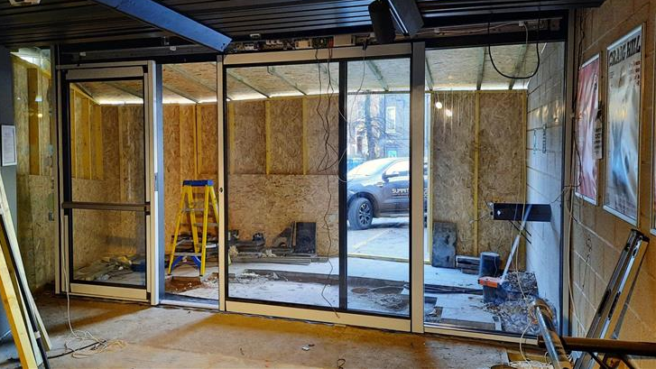
How did we do?
Collaboration between FAAC, Tayside Automated Doors and Nicol Russell architects and a design was born.
Planning decision making and completion took 17months.
We received Planning permission from Planning and HES without any problem.
Budget: £60,000 + vat, we came in at £56,467.95+vat
The project did have a very low carbon figure
We did work to advanced level of Theatre Green book
Use local Contractors
Time frame – 2 weeks- Completed in 12 days.

Slide 7
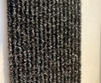
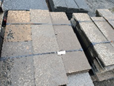
Low Carbon Footprint
All glass, steel, aluminium, stone and matting was fully recycled. The glass and steel etc went on to make new doors.
The matting was reused in carpeting
The stonework was, where possible was reused or recycled to make stone chips for gardens.
The New doors were made from recycled glass and metal.
The Matting was made from ocean waste plastics
The new stone came from a local quarry
Contractors came 1.5 miles away
Doors came from Glasgow
Temperature is averaging around 17oC with out heating

Slide 8
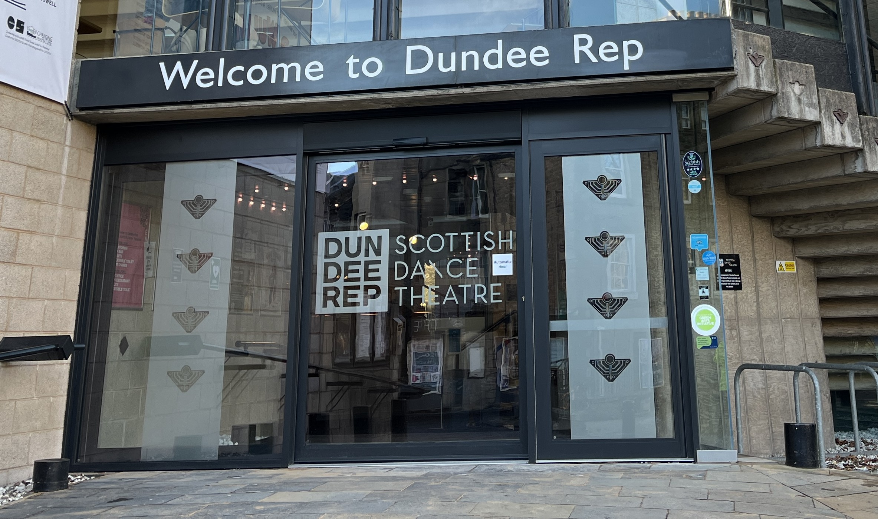
The New look

